Slide 1
pH 10.0
The Mysteries Alkaline Ionized Water Has Water For Life

Slide 2
Contents
Benefits From Drinking Clean Water 3
7. Main Compositions & Fetures Of The Filter 50
Preface 4
8. Functional Comparison Of Different Types Of Waters 51
1. Foods And Cuisines 5~7
2. Health And Beauty 8~13
Electrolyzed Reduced Alkaline Water
3. Cleanliness, Hygiene And Others 14~15
1. Electrolyzed Alkaline Water 53
2. Main Causes for The Body Becomes Acidic 55
Ways of Reverse Aging 16~41
3. Pre-Hepatic & Post-Hepatic Organs 56
Tips For Longevity 41
4. Comparisons On The Acidity & Alkalinity Of Foods 57
5. Changing Blood Colors & Blood Vessel 58
Functions Of Water
6. Our Body Consists 70% Water 59
1. Functions Of Water In The Body 42
7. Progression Stages Acidification In The Body Constitution 60
2. Aging And Water 43
8. The Main Causes, Leading The Body Constitution To Acidification 61
3. Acidity And Alkalinity Of Foods 45
4. Preconditions For Good Water 47
5. What Kind Of Water Are You Drinking Now ? 48
6. In A Diagram Of The Water Ionizer 49

Slide 3
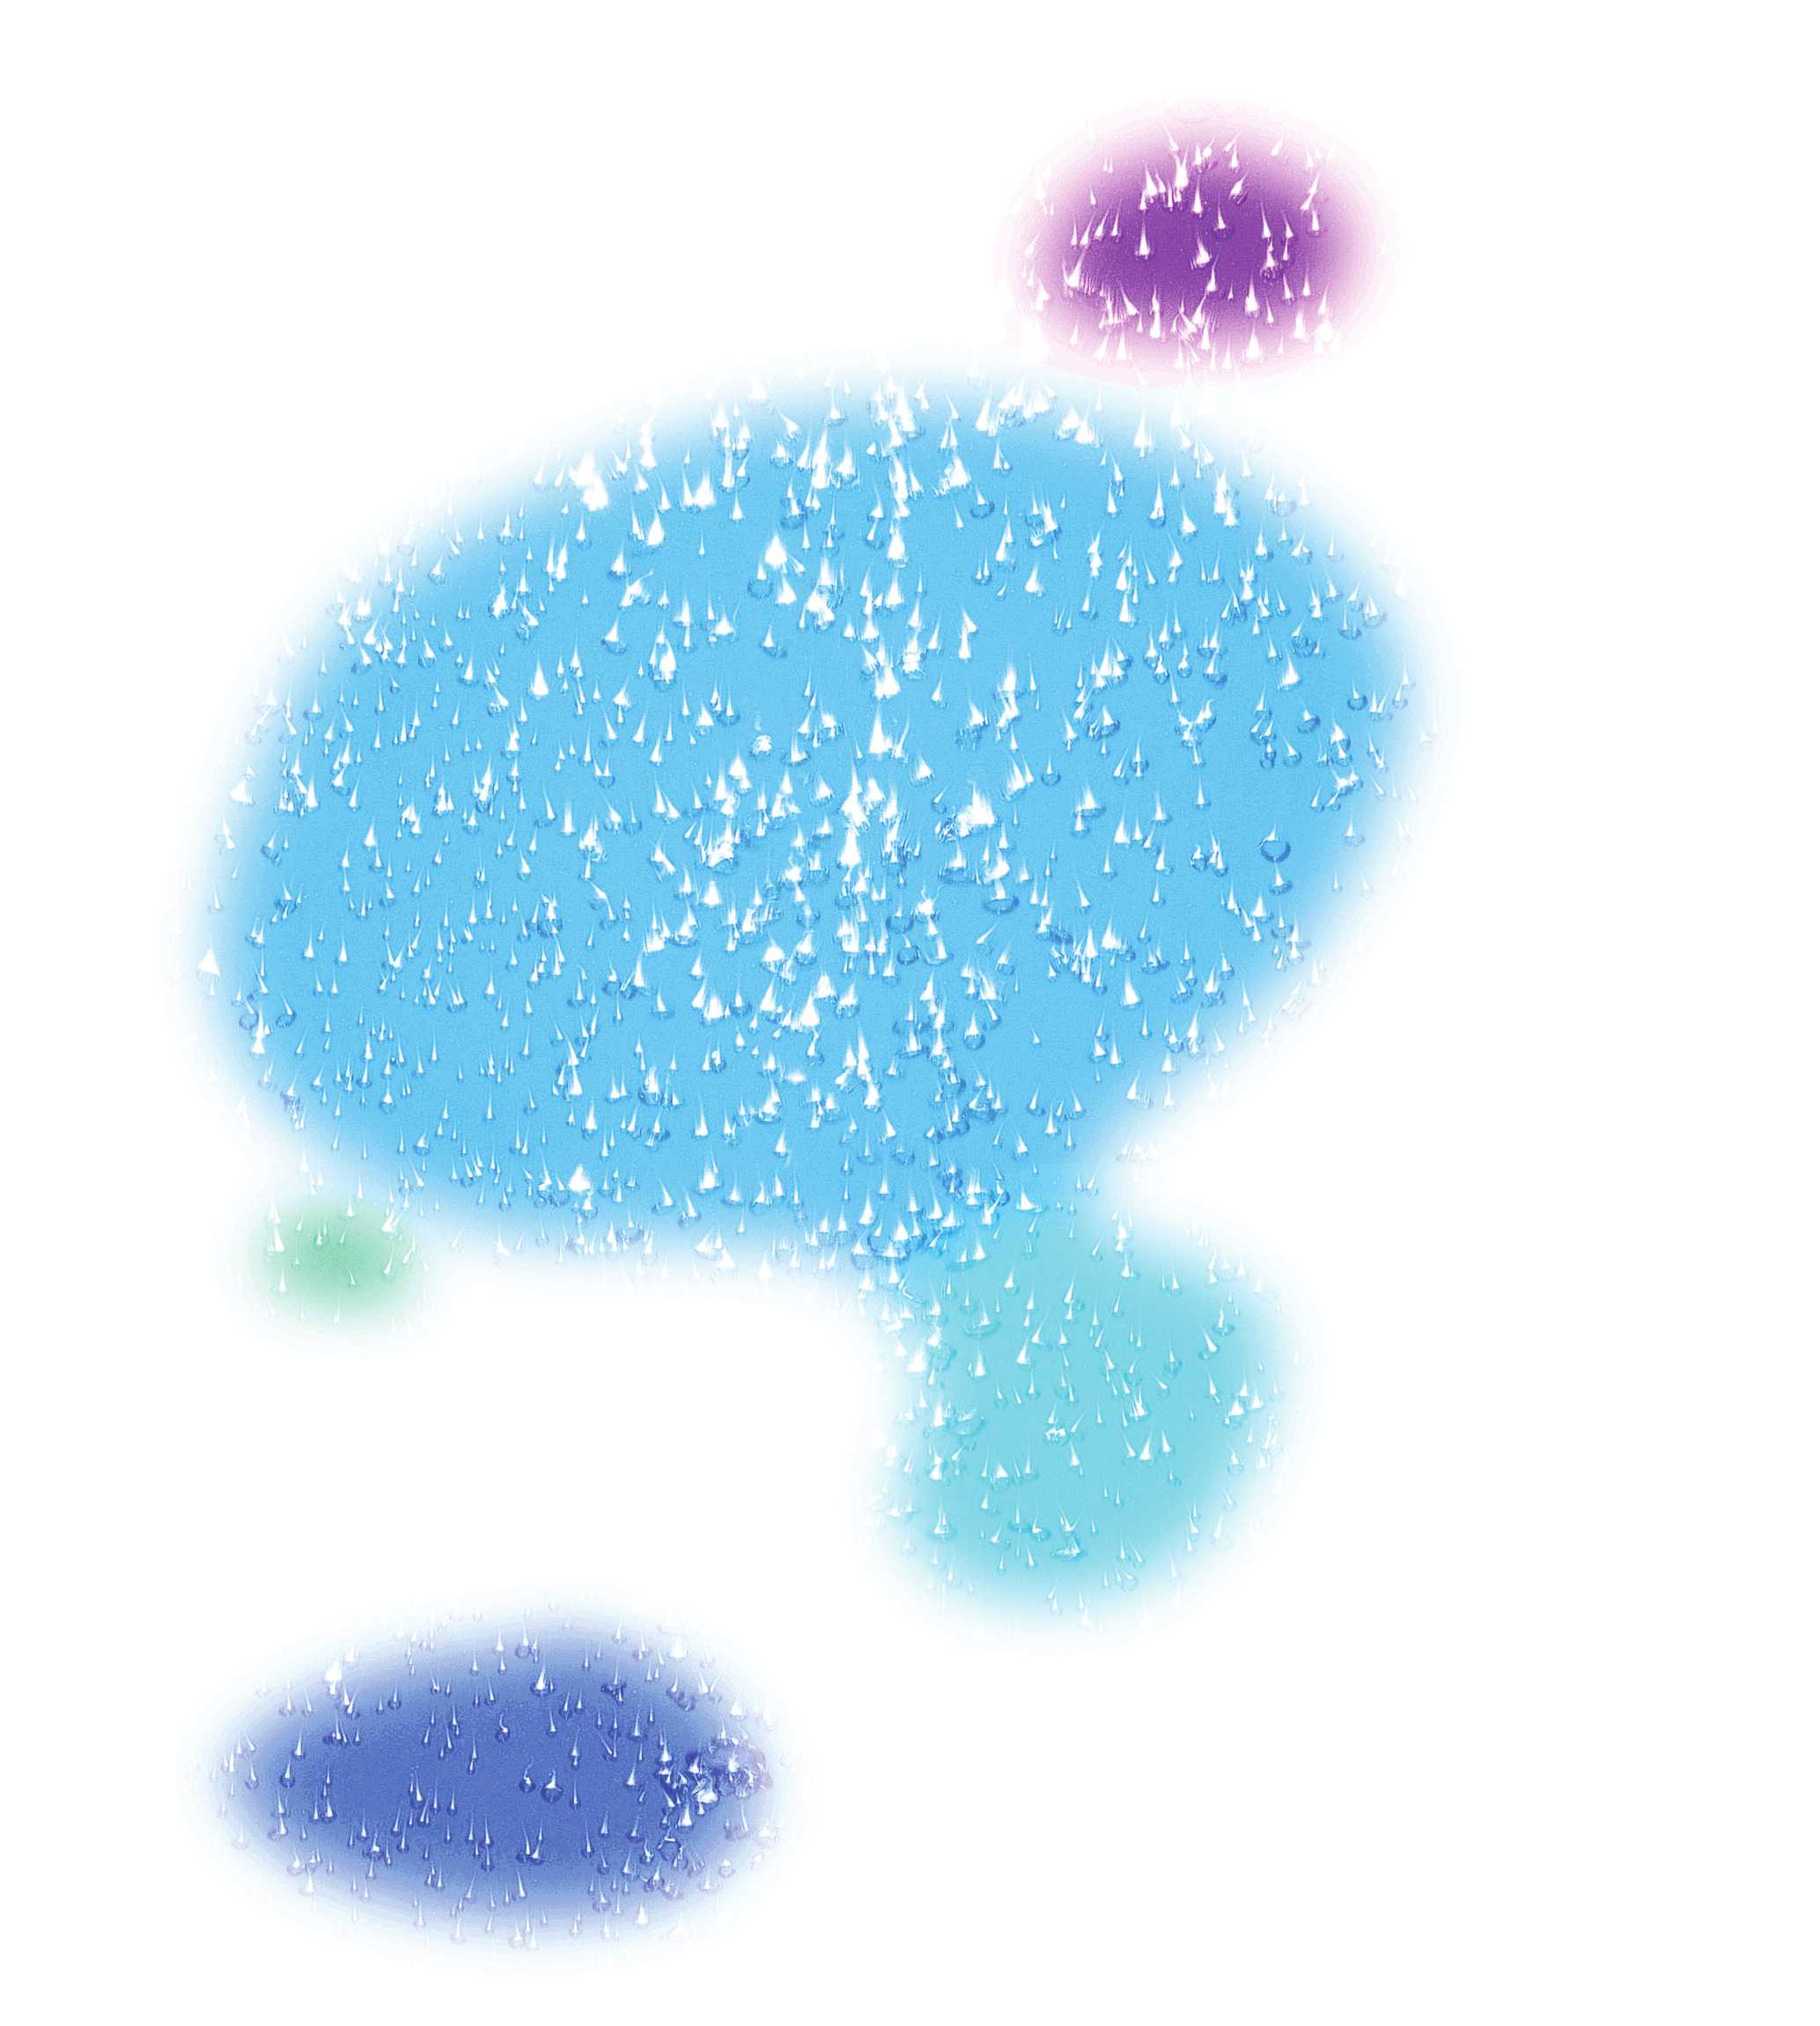
Benefits From Drinking Clean Water
Drinking Clean and Healthy Water Can Prevent About 80% of Illnesses
I have been a water-expert for over 30 years, studying the mysterious relationship between water
and life. As a statistical epidemiologist, my main focus was the study of water. I’m confident that I’m
one of the world’s top experts, as far as water is concerned.
And I’m proud of the fact that many of my studies over the last 30 years have been quoted and shared
by many scientists around the world. This shows that my study results have been incorporated into
people’s daily lives.What my study proves is the fact that the Human Body likes a hexagonal ring-
structured water.
The more hexagonal the water structure becomes, the more it promotes the good yield of green crops,
thanks to their accelerated physiological activity and an increase in plant-plankton. This particular
type of water also improves the hatching speed of chickens and helps with human anti-aging. The
World Health Organization has asserted that “about 80% of illnesses can be prevented by Drinking
Clean water.” I believe that Man can help to create an ideal world, full of health for all, if we
continue to maintain a good way of life by drinking water that contains a high ratio of hexagonal
ring-structures.
Dr. Chun, Moo Sik (Alias “Dr. Water”)
Dr. Chun had studied the relationship between water and life for over 30 years and is the founder of
the theory dealing with hexagonal ring-structured water in Korea
3

Slide 4
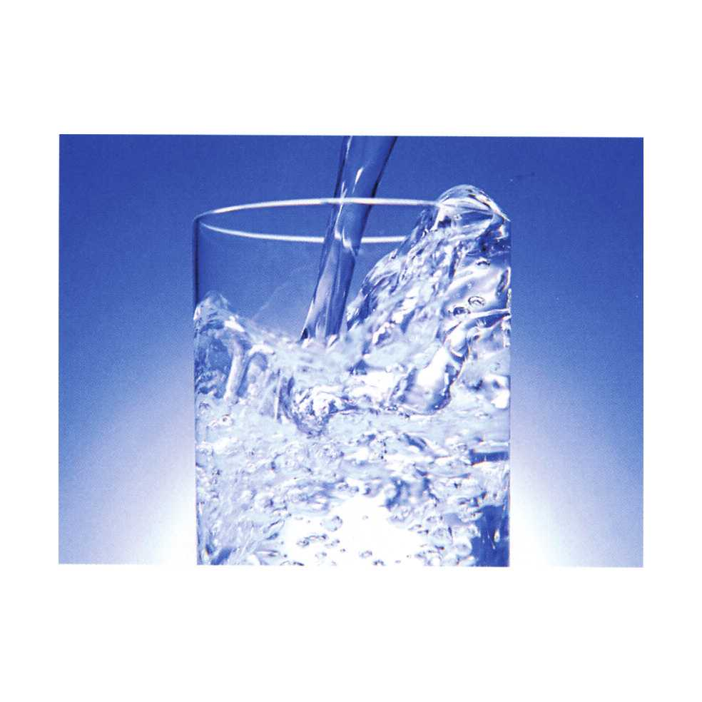
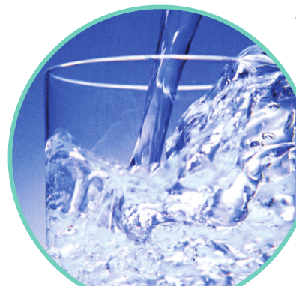
Preface
We used to feel that our natural environment was destroyed as industry
developed. Therefore, air and water have been some of our major
concerns to date. Electrolyzed Alkaline Water drew our attention in our
quest to find the best ways to maintain healthy daily lives. After our
relentless efforts to develop the ideal water ionizer, we, Biontech Co.,
Ltd. Introduced for the first time anywhere, a superb Water Ionizer,
equipped with the convenient functions of artificial intelligence.
The Electrolyzed Water Ionizer is a machine, producing both Alkaline
and Acidic waters at the same time. Our Water Ionizers are used in many
places, such as restaurants, hospitals, school cafeterias, workplaces as well as
individual homes. Unlike an RO water purifier, our ionizers are expanding to newer
and bigger markets, worldwide.
This book is a collection of stories from our users’ experiences of the powerful benefits they enjoyed from drinking the
healthiest water, Alkaline Ionized Water. You, the reader, can also share your own experience with other people.
We believe that speaking out about has more effective and powerful benefits than any other established types of
advertisement. The stories in this book can be used as a reference for the better understanding of the beneficial effects
that Electrolyzed Ionized Water can offer you.
4

Slide 5
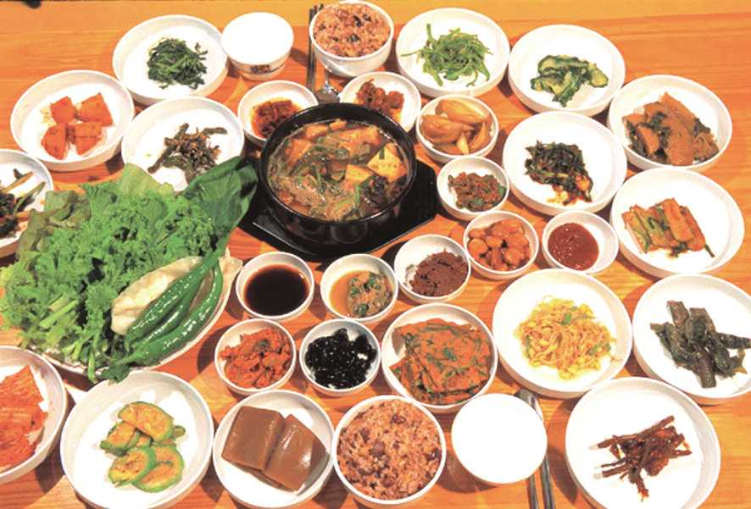
1. Foods and Cuisines
When an egg’s boiled
The reason why a soft-boiled egg is good for digestion is that its acidic cholesterol gives the egg a
Chewy texture, as the yolk is cooked. Here’s a cooking tip. If you put an egg in alkaline water and boil
it, you can enjoy a delicious soft-boiled, smooth & chewy egg about 5 minutes later.
Do you still boil water to prepare green tea? That can be an annoying task, especially
on a hot summer day. However, if you put a tea-pack in cold Alkaline water, you instantly have
a strongly-concentrated green tea, thanks to its excellent permeability by the smaller water
cluster of Alkaline Ionized Water than that of RO water, for instance.
When rice’s cooked
If you cook rice with Alkaline Water, it’s cooked fast and keeps its flavor without becoming mushy.
Plus, you will use a little less water than in common cooking. When you squeeze fruits or vegetables to
make juices to drink or to make extracts for condiments, you can preserve the freshness of the
leftovers by soaking them in Acidic Water, before storing them in the fridge.
If you’re worried about pesticides on the vegetables you eat
You can remove pesticides and bacteria on the vegetables by first rinsing them in Acidic
Water and then washing them with Alkaline Ionized Water. Acidic Water is five times stronger
than tap water in terms of its sterilization properties. Its strong acidicity can destroy about 99.9%
of viruses on the surface . It also accelerates the growth rate of crops and helps the to produce a higher yield.
Suppressive effects of electrolyzed reduced water on alloxan-induced apoptosis and type 1 diabetes mellitus-
Li, Y. ; Hamasaki, T. ; Nakamichi, N. ; Kashiwagi, T. ; Komatsu, T. ; Ye, J. ; Teruya, K. ; Abe, M. ; Yan, H. ; Kinjo, T
Springer Science + Business Media ; 2011
5

Slide 6
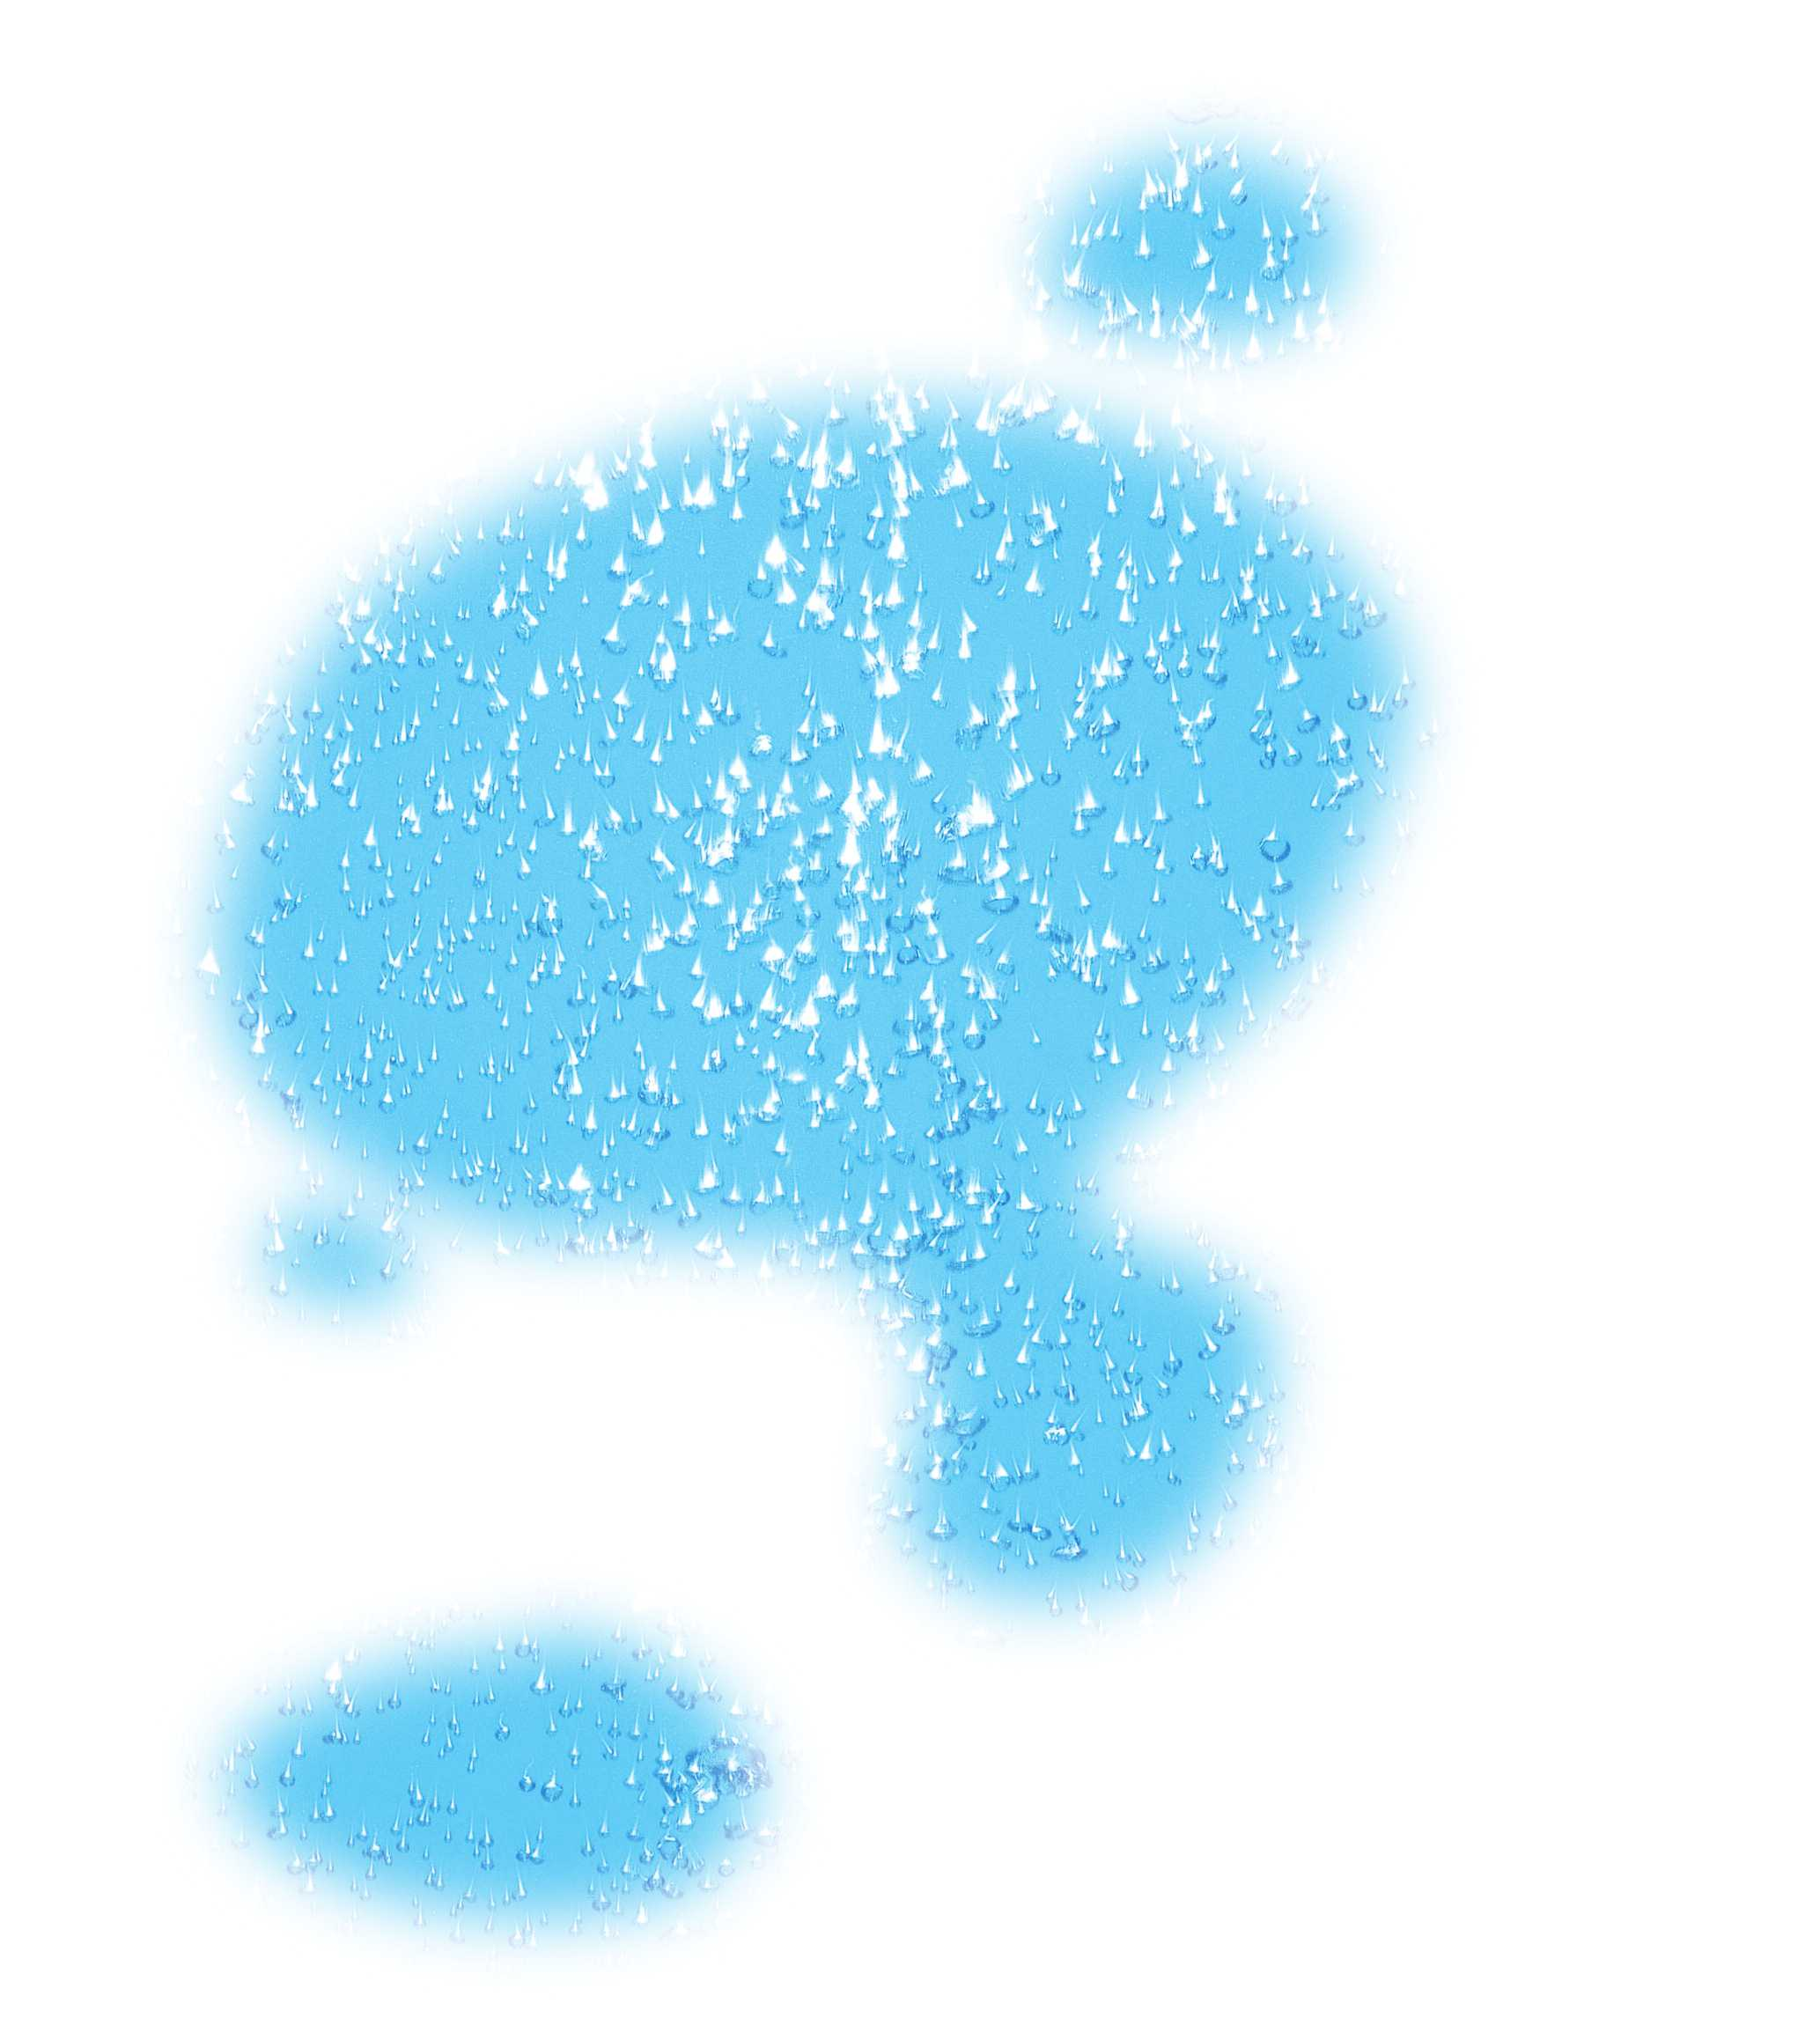
Dried Bread becomes soft again
Leftover Bread, kept inside in the fridge for a long time, used to get dried and hard to chew. You can
make it soft again by spaying it lightly with a mixture of Alkaline Ionized Water, a spoonful of sugar
and a couple of drops of whisky.
How to make beer cold
When a friend of yours drops by for a beer, you can cool a warm bottle of beer quickly by wrapping it
in a towel soaked in Alkaline Water and ice-cubes and fanning it briefly.
When you parboil green vegetables
You can enjoy the crispness of fresh green vegetables with their delicious flavor, if you parboil
them briefly in Reduced Alkaline Water, before eating or cooking.
How to remove Pork Fat
You can remove pork fat by dipping the meat in Acidic Water and rubbing it a little, before
cooking. If you boil pork in Acidic Water, you can increase the pleasure of chewing a tender piece of pork while reducing its fatty taste.
The melamine excretion effect of the electrolyzed reduced water in melamine-fed mice ;
Yoon, Y. S. , Kim, D. H. , Kim, S. K. , Song, S. B. , Uh, Y. , Jin, D. , Qi, X. F. , Teng, Y. C. , Lee, K. J.
Food and chemical toxicology ; 2011
How to enhance the taste of tea, coffee and spirits like vodka
Alkaline Water removes the bitterness of tea and coffee and enriches their taste . The taste of spirits
are improved with ice-cubes, made of Alkaline Water..
6

Slide 7
For Cooking Purposes
If you use Alkaline Water for cooking, it helps remove bitter tastes , tangy or pungent odors
from vegetables and also helps to reduce the odor from fish .
Powdered Milk
Powdered Milk, mixed with Alkaline Water helps enhance a baby’s body and the osteogenesis process.
When Noodles are boiled
If you use Alkaline Water to boil noodles or pasta, you will enjoy a softer, more pleasant texture.
Preventing Discoloration of Vegetables and Fruits
Fruits and vegetables, such as grapes, strawberries , red cabbage, beans and asparagus, are rich in
Anthocyan, which causes discoloration. However, fruits and vegetables washed in Acidic Water
and cooked later, maintain their natural color and freshness, longer than expected.
For Heavy Drinking and Hangovers
Drinking one or two glasses of Alkaline Water before going to bed, and after getting up, helps to overcome
a hangover and improves body metabolism.
To Wash Kitchenware that is dirty and scorched
You can remove dirt or food leftovers, scorched & stuck on kitchenware by simply putting it
in Acidic Ionized Water, overnight.
7

Slide 8
2. Health and Beauty
How to Remedy Eye-Sty and Mild Inflammations on the Skin
When you feel pain and discomfort due to a sty in your eyes or an inflammation, you can remedy it by
applying cotton-gauze soaked in Acidic Ionized Water, to the affected parts, which will be sterilized
and healed, afterwards.
Recover From Fatigue by Drinking Alkaline Water
If you are fatigued on a regular basis, you can regain strength by drinking Alkaline Water.
Alkaline Water is rich in essential minerals, such as Calcium, Magnesium, Sodium and Potassium.
Alkaline Water also has a high negative ORP(oxidation reduction potential), optimizes body balance,
reverses the effects of acidic waste, accumulates in the body and
maximizes resistance to diseases.
How To Treat Hair and Its Dandruff
I’d like to recommend that your hair be washed in Acidic Water. You can easily see the
difference after a couple of shampoos. Hair will be cleaner and softer, any dandruff will be gone, and
it will help to prevent hair loss.
For Slight Scratch and Cut-Wound
For Minor Scratches and Cuts Before applying any ointment or salve, wash the injured part in Acidic
Water. The injury will be cleaned and can then heal quickly.
8

Slide 9
For Those Who Suffer From Urine Retention and Prostate Hypertrophy
For Prostate Hypertrophy, which is caused by urine retention, it is recommended that you drink at
least 8 glasses of Alkaline Water (or 2.5 liters) a day. Alkaline Ionized Water helps hydrate the body
and scavenges Free Radicals.
For Colds, Constipation, Stomach Disorders & Diarrhea
According to Testimonials from users who suffered from chronic Colds year round, they experienced
improved immunity through the regular drinking of Alkaline Water. Their overall constitution
became stronger than before as well, and they were able to fight off Stomach Disorders, Diarrhea &
Constipation.
For Sickly Children & those suffering from Anemia
One of the users’ claims was that the Steady Drinking of Alkaline Water made their sickly kids (who
often fainted, due to lack of strength) healthier and stronger and the children gained weight because
they had better appetites
9

Slide 10
For Patients suffering from High Blood Pressure
One user suffered from High Blood Pressure for a long time and his daily life started with taking
medicine and finished with them, too. However, since he started drinking Alkaline Water, he,s no
longer a prisoner to a regimen he doesn’t need, and is getting better day by day. Alkaline Water is
absorbed through the Stomach wall after being taken in by mouth with 83% of it becoming part of
your blood where it improves immune function.
For Patients, suffering from Fatty Liver
A user who had suffered from Fatty Liver for a long time, was very meticulous about their diet,
avoiding eating fatty, greasy(acidic) foods. One of his friends introduced him to Alkaline Water and
recommended that he drink it. After a regular intake of Alkaline Water, he now feels the differences
in many ways. Not only is he well aware of the benefits, but his entire family have now become users
of the Water Ionizer.
For Rheumatic Pains
The micro-clustered permeability of Calcium ion-rich Alkaline Water helps get blood healthy and thus
helps improve rheumatic pain.
10

Slide 11
For Chronic Fatigue from a Deteriorating Thyroid Gland
One user was always fatigued due to a deteriorating Thyroid Gland & lack of sleep. However, he now
claims that he feels rejuvenated and seldom weary, even after lunch, since he started drinking
Alkaline Water on a regular basis
For Constipation
A user who suffered from constipation was advised to drink Alkaline Water and since then, he has
made it a rule to drink 8 glasses a day, excluding 2 glasses of Alkaline Water that he takes on an empty
stomach, first thing in the morning. Thanks to Alkaline Water’s stimulation, which activates
intestinal movement, he claims that he can comfortably answer Nature’s Call at least twice a day.
How to Deal With Insomnia
Another user was feeling very dragged out, fatigued by illnesses such as Arterial Sclerosis, Cardiac
muscle Sclerosis and Chronic Indigestion over a long period of time. As a result, he became thinner
by the day, and developed other conditions, including having a Nervous Breakdown and Insomnia.
However, since he became aware of the power of Alkaline Water, which he had been introduced to by
friends, he’s been drinking it steadily for about a month. Now he claims that he enjoys a sound
sleep at night and his complexion has gotten brighter and healthier than ever before.
11

Slide 12
To Reduce Foods Allergies
Another user is allergic to a couple of specific fruits and foods. Whenever he eats one of them
unwittingly, he feels unbearably itchy inside his mouth. On one occasion when that happened, he
used Acidic Water to take the nasty taste out of his mouth and after that, he says he felt comfortable
again.
For Overly Tanned-Skin and Atopic Dermatitis
If you moisturize overly-tanned skin by spraying it with Acidic Water, it will heal with no serious
inflammation or swelling. This treatment can be used for any Atopic Dermatitis. During the first week
of trying Acidic Water, you may see no obvious difference, however, as you move into the second
week , you begin to realize the swollen & itchy skin (Atopic Dermatitis) is not nearly as irritated, and
gradually it disappears.
To Alleviate Migraines
A user has suffered from severe Migraines, frequently feeling very weak. He used to complain about
the incessant pain they caused. However, he now claims that he eliminated the pain of his Migraines
by drinking Calcium-rich Alkaline Water, which enhances internal blood circulation and alkalizes
the body with a moderate supply of oxygen.
12

Slide 13
Launder a swimsuit to wash off the salt
After swimming, even though you wash the swimsuit, salt can still remain, damaging its
fabric and eroding its elastic. To clean a suit thoroughly, soak it in Acidic Ionized
Water for a while and then rinse it in Filtered Water. You,d always feel as if it were a
brand-new one, every time you wear it.
13

Slide 14
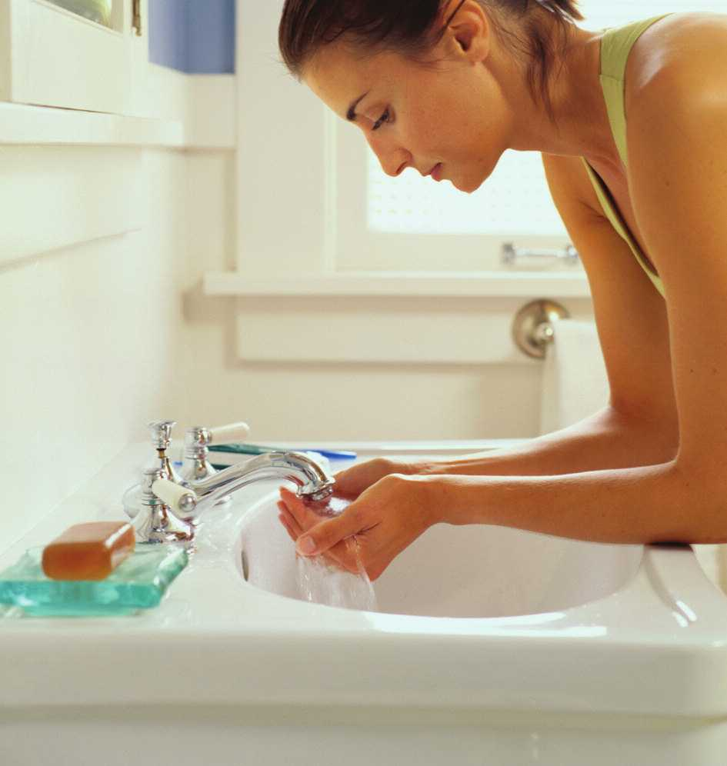
3. Cleanliness, Hygiene And Others
To remove stains on the tablecloth
A vinyl tablecloth that is marked with dirt or stains, can be cleaned by first spraying it with Alkaline
Water and then rubbing it with a gauze pad or towel, soaked in Acidic Water.
To remove stains on silk clothes
You can remove stains by patting the mark with a gauze pad or towel, soaked in Alkaline Water.
To Sterilize Kitchenware
You can sterilize various types of kitchenware, such as spoons, knives, dishes, cook-pots and many
more by putting them in Strong Acidic Ionized Water(pH 3.5) for a while. Thanks to its powerful
oxidation effect, the kitchenware can not only be washed off and come out clean, but it will also look
polished.
For Washing Your Pets
You can remove the odor that clings to your pets by washing them with Acidic Ionized Water and then
rinsing them with Filtered Water. Acidic Ionized Water can remove distemper in pets.
14

Slide 15
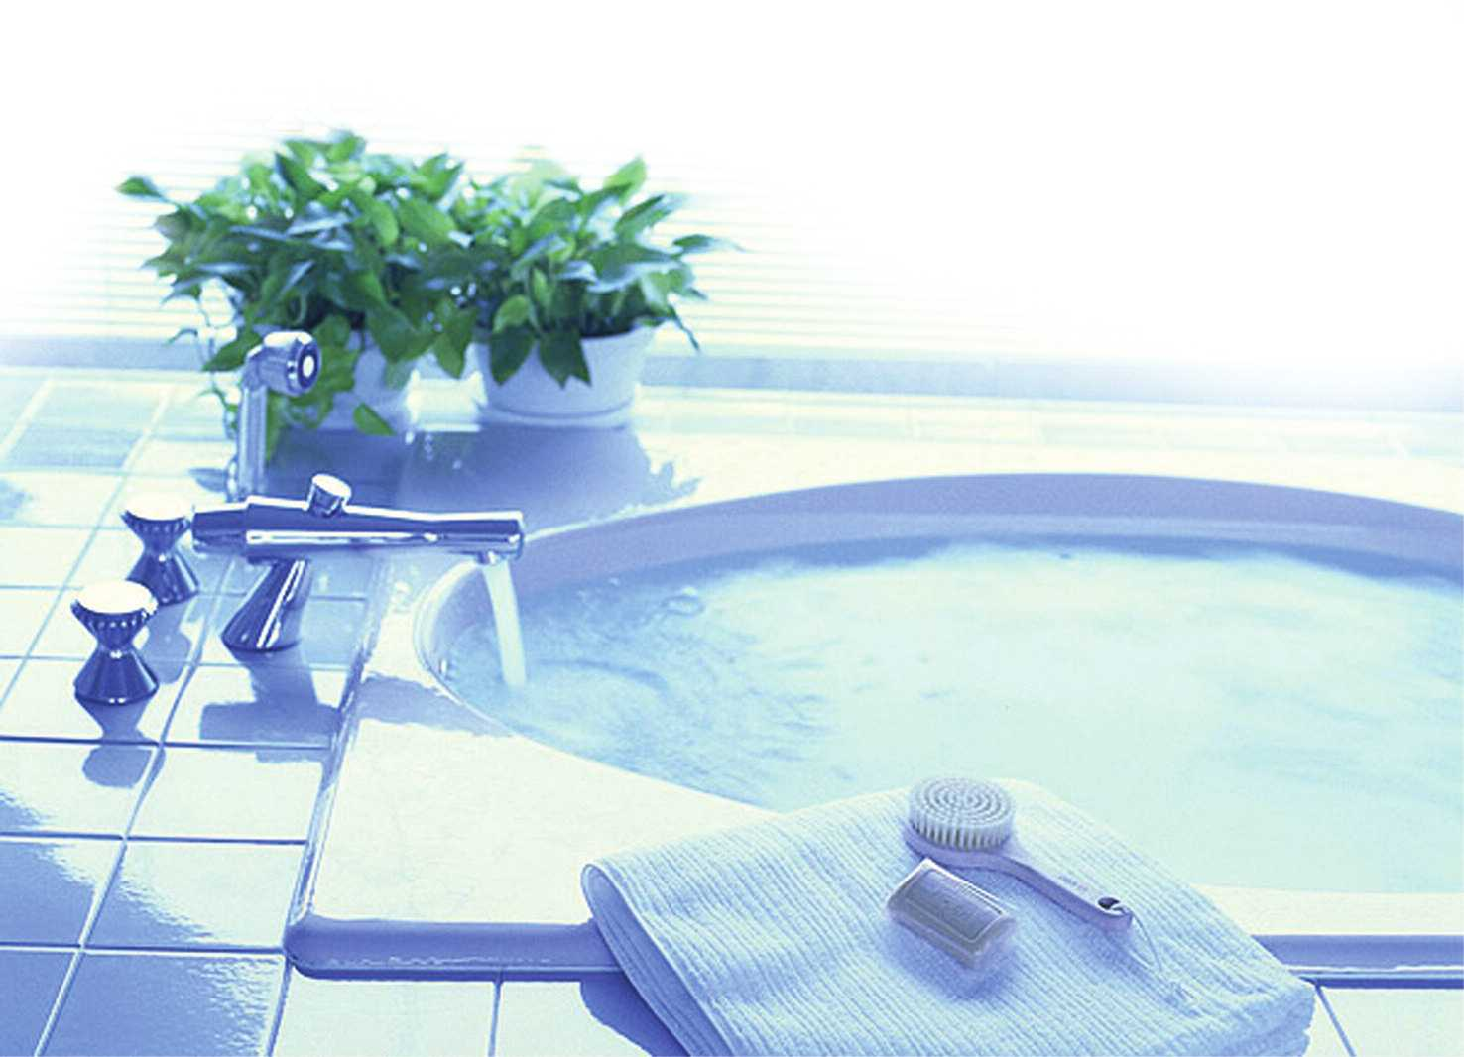
For Cleaning Purposes At Home
You can remove dirt and dust on mirrors, glasses, furniture & in the bathroom, by washing them with Acidic
Ionized Water. You can see the difference !
For Bathing and Washing Your Hair
Acidic Ionized Water has an Astringent effect, keeping skin soft and elastic, because skin has a weak-Acidic
pH(abt pH 5). I It can also give your hair a healthy shine, if you rinse it with Acidic Ionized Water. After
shaving, Acidic Ionized Water can be used as a skin-lotion, thanks to its Astringent Effect.
15

Slide 16
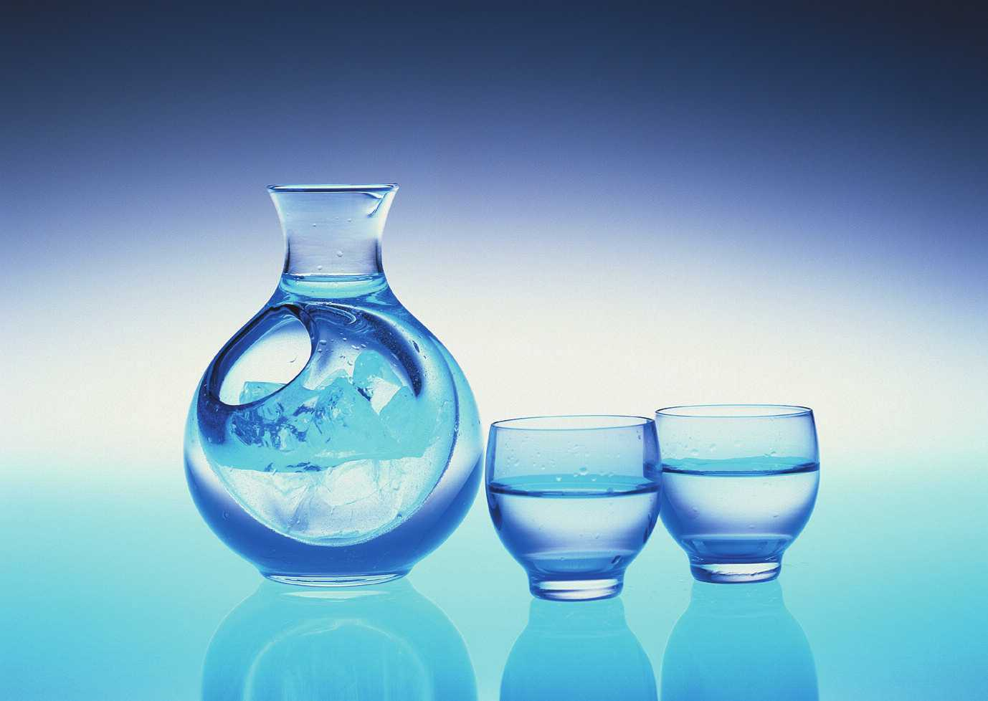
Ways Of Reverse Aging
The author of the book is Whang Sang Yeon, a scientist and inventor. He worked at SEG and other famous
electronics manufacturing companies as a supervisor in specific technology. He invented many items, such
as the multi-focal contact-lens, modems, electronic filters and various types of electronic parts. He now gives
lectures on Hydrogen-rich Alkaline Ionized Water and Reverse Aging to many people across the U.S.
16

Slide 17
Contents
1. Here Is The Key To Reverse Aging
14. Skin Wrinkles And Low Blood Pressure
2. Oxygen-abundant Alkaline Ionized Water
15. Constipation & Chronic Diarrhea
3. Wastes From Foods
16. Animals Like Alkalinity
4. Gastric Hyperacidity & Alkaline Water
17. Alkalinity & Gene Chromosomes
5. Alkaline Water Helps Neutralize And Balance
18. Alkalinity and Magnetic Force
body’s pH
19. Air Pollution And Acidic Wastes
6. Wash Off Waste
20. Research Tata On Alkaline Ionized Water
7. Mysterious Functions Of Live Cells
21. Metabolism And Malnutrition
8. Exercise Dissolves Wastes
22. Tips for Longevity
9. Balanced Diet
10. Things That Cause High Blood Pressure
11. Alkaline Water, An Elixir Of Youth?
12. Alkaline Water, Dissolving Kidney Stones
13. Kinds Of Illnesses And How To Prevent Them
17

Slide 18
1. Here Is The Key To Reverse Aging
First, let us see how we get old !
All living cells produce waste. The nutrients we take from foods are delivered to the body cells and after the
nutrients are combined with oxygen, they’re burned. It’s waste in which the nutrient is burned. All foods
turn into waste, regardless of whether they’re healthy foods or not. There is only one difference between
what’s healthy food and what’s not, whether it is big or small, volume-wise and whether its waste is Acidic or
Alkaline.
The body cell lasts about 4 weeks through its own metabolism. Dead cells also turn into waste. All the
internal wastes which are Acidic have to be discharged either in urine or sweat. However, for many
reasons, your body can’t discharge all the Acidic Internal Waste! We go through our daily lives,
accumulating new Acidic Waste on top of old Acidic leftovers, day after day.
There are reasons why the body can’t discharge all the waste. One is the fact that the body can’t properly
dissolve and discharge wastes, due to a lack of rest & sleep from busy lifestyles. And to make matters worse,
you are what you eat ! Most of our favorite foods, such as breads, noodles, meats, junk foods like hamburgers
and pizzas, are all Acidic, except fruits & vegetables like lemons, kiwis, oranges, lettuce, broccoli and etc...
And lastly, the environment you’re now living in, has lots of pollution, such as contaminated water & air,
harmful ultra-violet rays, pesticides and chemical sterilizers, doing harm to your body cells.
18

Slide 19
Now what happens to the waste that is left behind ? It becomes solidified and accumulates somewhere inthe
body, piece by piece. This accumulation process is the very process of aging. Depending on where the waste
has accumulated, you get different types of illnesses.
If no waste accumulated inside the body, you would not age. Reverse Aging means removing waste from
the body. Alkaline Ionized Water alkalizes the body, neutralizing and then hydrating the waste more
efficiently. Alkaline Water is not a medicine, that cures illnesses, but through the steady drinking of it,
Acidic Wastes are reduced and thus body condition is improved, showing sound & healthy metabolic
processes, amongst users.
Just like we wash off dirt off our hands with a soap which is Alkaline, we need to wash off Acidic Waste with
Alkaline ionized Water. Now I’ll tell you more about the influences that Waters (Alkaline & Acidic) and Acidic
Waste have on your body and how drinking Alkaline Water can benefit you and affect any illness you have.
19

Slide 20
2. Oxygen-Abundant Alkaline Ionized Water
As you know, the formula for Water is H2O. Oxygen has a negative pole and Hydrogen has a positive one.
Water molecules don’t exist individually, but in combined form with multiple oxygen molecules.This
combination creates a pentagonal or hexagonal structure. Water molecules are electrolyzed into Hydroxyl
ions (OH-) and Hydrogen ions(H+). Water that has the same amount of (OH-) and (H+) is said to be neutral or
“pH 7.” When Acidic materials are added to this neutral water, the Acidics kick out the oxygen and enrich
hydrogen ions in the water. For instance, you could say that there’s onlya five-tenths square of water
molecule per one hydrogen ion, meaning the water is only pH 5 (Acidic Water).
If you compare the same eventity water that is pH5 is ahundred times higher in hydrogen ions, them water
that is pH7.
One interesting point I would like to mention, is the fact that when the hydrogen ions are 100 times higher
than the level in neutral water, the hydroxyl ions are automatically reduced to one-millionth the level
found in neutral water. In other words, Acidic Water carries more hydrogen ions than hydroxyl ions and
Alkaline Water carries more hydroxyl ions thanhydrogen ions, meaning that there’s more oxygen in
Alkaline Water than in neutral water. On the other hand, Acidic Water has less oxygen than neutral water.
Oxygen-rich and Acidic Water’s said to be Oxygen- poor.
20

Slide 21
3. Wastes From Foods
The foods we take in daily, consist mainly of carbohydrates, fats and protein. The chemical elements for
these three nutritional sources are carbon, nitrogen, oxygen and hydrogen, which all exist in the air.
The taste & the nutritional value of a food depend on how these four elements are grouped. Besides these
four elements, there is an average of one percent inorganic minerals in every food. The inorganic
Alkaline minerals are Calcium, Magnesium, Potassium, Sodium, and Iron. The inorganic Acidic minerals are
Phosphorus, Sulfur and Chlorine. All these inorganic minerals give foods their unique taste or flavour. We
can define whether a food is Alkaline or Acidic by the inorganic minerals it contains.
If digested food is not completely broken down inside the body, the leftovers become solid Organic Acidic
Waste and later turns into Fatty Acid or Cholesterol. In this solid Organic Acidic Waste, there’re also some
Inorganic Acidic Minerals (or Wastes). These inorganic Acidic Wastes can be easily discharged out of the
body, after they are combined with Inorganic Alkaline Minerals and neutralized. For that reason, eating
Alkaline Mineral-rich foods such as fruits and vegetables is a recommendation for your daily diet. Regular
drinking of Alkaline Ionized Water can maintain your health and help you reverse Aging by balancing the
metabolism within your body.
21

Slide 22
4. Gastric Hyperacidity & Alkaline Water
We know that stomach juices are strongly Acidic, which sterilizes any pathogens & bacteria, that enter with
food. The Homeostasis of the body keeps the pH level at a constant level of around pH 4. When the level is
raised above pH 4 by drinking Alkaline Water, the stomach-wall secretes Hydrochloric Acid and counteracts
it by reducing the pH level to pH 4 again. . Hydrochloric Acid is comprised of NaCL, CO2 & H2O molecules.
Hydrogen(H) is combined with Chlorine(Cl) to become Hydrochloric Acid and other molecules turn into
Caustic Soda(HaHCO3) which is Alkaline and later goes into the blood vessels. Therefore, we can say that the
more you drink Alkaline Water, the more Hydrochloric Acid & Caustic Soda are also produced. In other words,
something Acidic has to be produced, in order to produce something Alkaline. Your pancreas does exactly
the same thing. Food digested in the stomach, carries strong Acidic Stomach
Juices and can harm the intestines, the next organ it moves into.
Therefore, the Pancreas produces Alkaline Caustic Soda to be mixed with
food from the stomach and in the course of doing this, Hydrochloric
Acid is made and sent to the blood vessels in order to balance the pH
level. The Alkaline Ionized Water neutralizes
the Acidic Waste and is then discharged by the process of internal
hydration.
22

Slide 23
5. Alkaline Water Helps Neutralize And Balance The Body’s pH
The body has a function that we call “Homeostasis” which tries to maintain the inherent body balance
in terms of pH level. For instance, our body temperature is about 37 degrees Celsius. When it’s cold, our body
burns more internal fats and increases the body’s temperature. On the other hand, when it’s hot, our body
perspires, reducing the body temperature. Our body further controls its temperature by sending more
water into the lungs, thus lowering the temperature.
That is how our body maintains a certain amount of control over the level of pH in our blood. The pH
ranges from 7.30-7.45 which is defined as “Weak Alkaline.”By dint of Homeostasis, Blood pH can be
maintained within a very narrow margin. Otherwise, it would pose a great danger to our body. For example,
if you mix ten gallons of distilled water (pH 7) with ten ounces of Coke (pH 2.5), it turns into a liquid that is
pH 4.5. Though you drink this liquid (pH 4.5) or even a Coke (pH 2.5), it doesn’t pose any danger in terms of
the changes in your own pH level. In theory, a man would die from a radical drop to pH 4.5 from the normal
level of pH 7.45. However, the body works hard, maintaining its innate pH level even under harsh
circumstances.
It,s amazing from a scientific viewpoint to see how the body can maintain its innate pH level This is how it
happens: first, blood in veins, circulating back with acidic wastes, carries more acidic than blood in an
artery. This venal blood goes into the lungs, raising the pH level by emitting carbonate acid gas and
afterwards, solidifying the acidic waste-leftovers, preventing them from dissolving in the water. For
reference, because the acidic waste is not dissolved in the water, it doesn’t assert any acidic influence on
the pH.
23

Slide 24
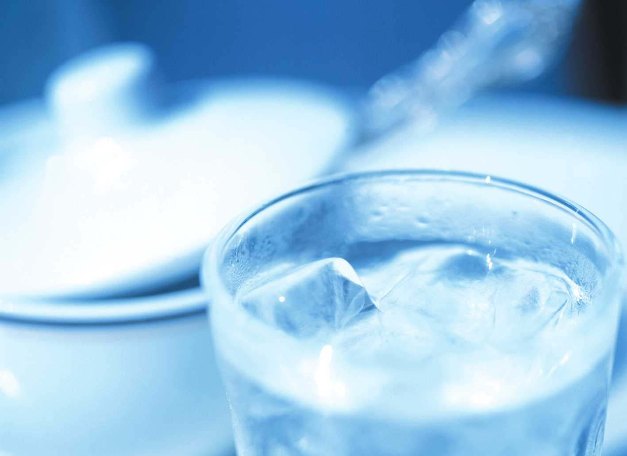
6. Wash Off Waste
I’m often hear questions from many people as to whether it would be helpful or not, if they drink 5 glasses
of any type of water a day. Of course, I tell them that any water, would be better than drinking none at all.
However, I,m going to explain why Alkaline Ionized Water is far better than just any type of water and
how it helps relieve the symptoms of various types of illnesses.
When you take a bath, you use soap to remove skin dirt. The skin dirt is Acidic wastes and soap is Alkaline.
Therefore, the skin dirt is neutralized by the Alkaline soap and is easily washed off. Unless washed
regularly, our skin gets irritated and is prone to disease. Drinking Alkaline Ionized Water plays the same
role for the body, washing awayAcidic Waste, as an Alkaline soap does with skin dirt. If you drink Alkaline
Ionized Water on a regular basis, you can cure any type of skin-related disease with no serious side-effects.
However, the accumulation process of body waste is a slow one and therefore, its removal cannot be done
overnight. Therefore, drinking a large quantity of Alkaline Water in a short period, would not do any good.
24

Slide 25
7. Mysterious Functions Of Live Cells
Now I’m going to talk about a living cell’s amazing intelligence. Your life starts from a small. Half of it’s
chromosome comes from your father and the other half comes from your mother. This tiny little cell
subdivides over and over and later becomes a human like us.
It’s fascinating when you consider how each specific cell ends up carrying out its own genetic actions, at a
time and place that is programmed by heredity, such as forming a hair or a nail, without any map or an
instructions from an outside agent. Therefore, you can call the cells smart ones, on the contrary, the cell
becomes a cancerous cell, if a cell loses its own smart job.
The nutrients we take in are delivered evenly to the entire body, and each cell absorbs only the amount they
require. When there are not enough nutrients available, the body itself redistributes what is available for
use to the organs that need them the most. Another amazing thing that cells can do is how they respond to
foods & chemicals taken into the body, categorizing them as beneficial or not. Every substance is made up of
its own unique molecules and each one of those molecules has its own specific vibration frequency. Body
cells sense this vibration, magnified through sensitive antenna, reacting positively, when it’s meant to be
beneficial to the body or reacting negatively, when it’s harmful to the body. This reaction is shown by
changes in the electrical resistance.
25

Slide 26
8. Exercise Dissolves Wastes.
When it comes to Health, you may think of exercise and a diet. We all know that exercise is good for your
health, however, we’re not very well acquainted with the relationship between Acidic Waste and Exercise.
It’s true that muscles develop through exercise and their strength increases as we continue exercising,
however, it’s not always right to say exercise is good for your health.
The body gets warm and perspires during physical exercise. As the body heats up, the capillary vessels dilate
and the heated blood dissolves wastes, making it easier to discharge them out of the body. This is the first
stage in the reduction of wastes. Because of that, a person whose body constitution is Acidic, often gets dizzy
and collapses after he or she exercises rigorously.
26

Slide 27
This type of collapse is caused by a lack of oxygen from the sudden drop in pH level, which lasts for a short
period of time until the wastes are properly discharged. Rigorous exercise can produce Lactic Acid, due to
the incomplete combustion of starch from the slow oxygen supply.
Lactic Acid is a major cause of asthma, during or after exercise. There are some users who say that their
asthma is gone, since they began drinking Alkaline Ionized Water. The most desirable exercise is one in
which you can use your whole body, because whole body exercise can help spread out the body wastes,
preventing them from accumulating in any specific place. Thus the body experiences no concentration of
these wastes. Whole-body exercise on a regular basis is very effective in weight loss, because the foods that
we take in are duly burned and discharged, leaving no wastes to accumulate. Drinking Alkaline Ionized
Water is particularly valuable because it helps neutralize Acidic Wastes and discharges them out of the body
as urine or sweat.
27

Slide 28
9. Balanced Diet
There are two ways of viewing the relationship between foods and health.One is the “Balanced
Diet,”supported by general nutritionists, who say that we need to take in the required nutrients from
various types of foods. The other is “Dietetic Treatment,” which is divided into two different approaches, that
is, The Vegetable ? only diet and Macrobiotic diet.
Even among those professionals who promote a Macrobiotic diet, there is a difference of opinion, which
confuses people. In a hospital, there are specific professionals who analyze and decide what a patients’ daily
diet should include. These professionals are generally nutritionists. Their main interests and concerns are
the food-nutrients we ought to take in. However, they don’t pay much attention to the Acidic Wastes those
very foods leave in our body.
On the other hand, professionals who prefer Dietetic Treatment pay great attention to AcidicWastes. These
professionals usually categorize which food is good or bad to eat, according to the Acidic Waste it generates.
But the trouble is, they apply the way they prescribe medicine to foods. This kind of application is criticized
by the medical sector, because foods are prescribed by the standards of outdated statistics and theory, not by
individuals’ symptoms.. Therefore, it makes sense that we take charge of our own health, and try not to eat
too much, or eat an unbalanced diet. In addition, we need to drink Alkaline Ionized Water regularly to help
discharge Acidic Waste from our body, and maintain our health.
28

Slide 29
10. Things That Cause High Blood Pressure
There are many people who suffer from high blood pressure, these days. Those who have it often collapse,
without any obvious pain. The main cause is that when the body lacks a supply of oxygen or blood, it reacts
by radically raising the blood pressure to try and improve the supply. You can identify high blood
pressure as having two causes. One is a physical cause and the other, a chemical cause. The physical cause
occurs when blood vessels become narrowed by the capillary vessel’s congestion or accumulated waste in
the artery. Without a proper blood supply, the blood pressure has no choice but to continue increasing.
Chemical cause is is due to a lack of oxygen or lots of Acidic Wastes, solidified inside the blood vessel and as a
result, the body reacts in the same way, by raising the blood pressure. If you have a radical fluctuation in
blood pressure, it is most likley chemical in origin.
There are two main substances depriving you of oxygen. Cigarettes and Sugar. Sugar can use up and deplete
oxygen faster than any other substance. You can say that Acidic foods, cigarette smoking and sugar are the
worst influences on high blood pressure, because what they have in common is that they reduce the level of
oxygen in the blood . It’s therefore reasonable for us to say that the more Alkaline Ionized Water we drink,
the healthier we will be.
29

Slide 30
11. Alkaline Water, An Elixir of Youth ?
The Aging Process is a process of accumulating Acidic Waste and the Reverse Aging Process is a process of
reducing accumulated waste by drinking Alkaline Ionized Water. Since ancient times, Longevity has been
mankind’s dream. I In the ancient East, many emperors and rulers sought an Herb For Eternal Youth, and at
the same time in the ancient West, the Fountain of Youth was sought by many rulers. When you think about
the benefits of Alkaline Ionized Water, it is clear why ancient people tried to seek a Fountain of Youth.
30

Slide 31
12. Alkaline Water, Dissolving Kidney Stones.
When there’s too much Acid in the Kidney, its functions get weakened and many Acidic Wastes are left in
the blood to wander around, . However, this clever cell doesn’t dump but retains them, for it picks it up,
quickly, if any further waste-dumping incurs a risk to the life. Because each cell produces its own waste, in
order to survive it must routinely dump the waste by flushing it out into the blood. This retention of
accumulated acidic wastes in the cell brings about swelling in our body. But if you drink Alkaline Ionized
Water, the swelling goes away as blood gets alkalinized, and the cell reacting to the change, discharges
the wastes safely. Kidney function is also improved if the blood becomes more alkalinized. Thus, it’s
reasonable to say that urinary output can double after you drink just one glass of Alkaline Ionized Water.
Too much Acidic Waste in the Kidney often causes Kidney Stones which are made from urine and
phosphorous acid. These stones can damage the Kidney or the Bladder.
Calcium and Magnesium in the blood are extracted from the blood and combined with the Strong Acidic
urine and phosphorous acids, in order to reduce them. This is the very process by which the Kidney Stone is
formed when the urine & phosphorous acids solidify. A Kidney Stone causes trouble because it is hard to
dissolve in the urine. The more strong acidic the Urine & Phosphorous Acids, the less Calcium & Magnesium
in the blood. In an effort to cope with the lack of these minerals, our body reacts by leaching Calcium from
the bones, causing Osteoporosis. Drinking Alkaline Ionized Water on a regular basis reduces the acidic
nature ofurine and subsequently dissolves the Kidney Stone, little by little.
31

Slide 32
13. Kinds Of Illnesses And How To Prevent Them
Dr. Menken was once quoted in the New England Journal of Medicine in 1919 as saying “The cause of our
worst troubles in life is not temptations such as sin or money, but Hydrogen Ions.” Hydrogen Ion stands for
Acidic. There are three major adult diseases caused by excessive Acids. The first one is Osteoporosis in which
Alkaline body minerals like Calcium & Magnesium are leached out of the bones. The second type is the
Kidney Stone, Arthritis & Gout which are commonly caused by Strong Acids & Acid Salts, causing
inflammation in the joints or the organs. The last one is Diabetes, Kidney Trouble, High Blood Pressure &
the many kinds of Cancers that are all generated from capillary vessels clogged by solidified acidic wastes
Many Adult Diseases are commonly caused by Hydrogen ions or acidic ions and therefore, we can see that we
ought to use Alkaline Hydroxyl Ions as a weapon against Acidic Hydrogen Ions. In other words, through
drinking Alkaline Ionized Water, we can effectively prevent or fight many types of Adult Diseases. All we
need is to just”Go For It.”
32

Slide 33
14. Skin Wrinkles And Low Blood Pressure
Alkaline Ionized Water is not a medicine meant for removing wrinkles, but if you look at the wrinkles on
the face of the aged you can see how poor blood circulation causes thickened skin. Wrinkle lines are a
result of acidic wastes because the skin is suffering frm poor blood circulation. As the skin loses its
elasticity, it turns rigid and is pushed into wrinkles. Even if you can temporarily reduce or remove the
wrinkles by applying lotions or skin-care cosmetics, the wrinkles will only reappear if the fundamental
cause, that is, accumulated acidic wastes beneath the skin are not properly taken care of. Regular drinking
of Alkaline Ionized Water can improve the skin, by constantly reducing the acidic wastes that accumulate
beneath it. This is the better and more effective approachto skin care & wrinkle removal than to cover it up
temporarily with cosmetics. [B13]When a person has Hypotension, the heart muscle becomes less active,
because there aren,t enough Calcium Ions in the body. However, hypotension vanishes if you drink
Alkaline Ionized Water, rich in Calcium ions, releasing the Calcium ions held captive by acid salts.
33

Slide 34
15. Constipation & Chronic Diarrhea
Professor Choi, Gyu-Wan at Seoul National University released a research paper, claiming that drinking
Alkaline Ionized Water solves Constipation, at a lecture meeting of “Health, Disease & Water,” in September
1989. The summary of it is as follows :
After observation of 15 patients(10 males & 5 females), suffering from constipation for over a year, 12(8
males & 4 females) of them confirmed they were able to have a daily bowel movement within one or two
weeks after starting to drink Alkaline Ionized Water. Professor Choi, in his conclusion, stated that there was
an obvious difference between their conditions before and after drinking Alkaline Ionized Water. I In most
cases, the patients not only got relief from their Constipation but also the uncomfortable symptoms that
accompany it. The large intestine needs to secrete a lubricant to pass feces smoothly. If Acidic Wastes
accumulate, blood circulation gets worse, causing Constipation. Drinking Alkaline Ionized Water will
improve circulation and avoid Constipation. When digested foods leave the Stomach and enter the
Intestines, it carries a strong Acidicity, so our body neutralizes it with Sodium bicarbonate (or natural
Alkaline Juice), before the body passes it into Small Intestine. However, when the body cannot neutralize
properly using its natural Alkaline Juice, the foods which pass into the Intestines carry a Strong Acidity,
causing Diarrhea. For those who suffer from this type of disorder, drinking Alkaline Ionized Water will help
improve their symptoms.
34

Slide 35
16. Animals Like Alkalinity
A live cell maintains its life, generating energy by combining food-nutrients with oxygen from the air. It is
a fact of life that Man gets sick and eventually meets his or her end, due to the incomplete discharge of
burned waste-leftovers, inside the body. This can apply to animals as well, including birds and fish. Oxygen
is necessary to all life, however, there are cells, micro-organisms & germs which can live even without
oxygen. There are also plant cells, inhaling carbon acid gas and exhaling oxygen into the air. But animals
inhale oxygen and exhale carbonic acid gas. Another living thing that is capable of living without oxygen,
is the Cancer cell or Acidic Cell. Within the body, a healthy cell dies from lack of oxygen, due to accumulated
Acidic Wastes, while some ordinary cells turn themselves into acidic cells, in order to survive. It is the
beginning of various Cancers. Although these acidic cells are plants in nature, emitting small amounts of
oxygen in the initial stage, but once breeded later, these cancerous cells attack the body and Man later dies
of them with aging. I’d like to emphasize“Prevention is better than a Cure” The best prevention is to drink
Alkaline Ionized Water on a regular basis, discharging as much Acidic Wastes as possible without letting
them Accumulate inside the body. There are several bacteria caused skin diseases like eczema, ringworm,
skin mold, athlete,s foot and skin cancer. These bacteria are fond of an Acid Environment.
Therefore, they tend to thrive instead of being sterilized in an Acid
Environment. In this case, it would be good to sterilize them with
strong Acidic Ionized Water and then rinse with Alkaline Ionized
Water.
35

Slide 36
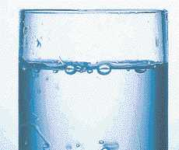
17. Alkalinity And Gene Chromosomes
Half of a person’s chromosomes are from his or her father and the other half from his or her mother. The basic
structure of this chromosome stays unchanged, even after several decades. Therefore, a lost child can later his or
her biological parents through a genetic DNA test. Everything in the environment surrounding us, such as what
we eat, what we feel and the germs we’re exposed to, can affect our chromosomes, either beneficially or
malignantly. In order to maintain healthy genes, we need to strike a balance between Alkalinity and Acidity.
Alkaline Ionized Water, washing off wastes in the cells can play a very important role in keeping the
chromosomes in good health for a long time.
36

Slide 37
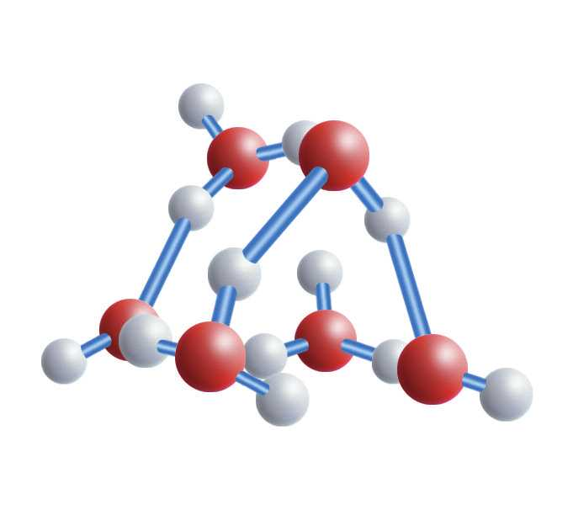
18. Alkalinity And Magnetic Force
Energy from the Sun,s rays brings us various benefits when it reaches the Earth. One of the benefits we get
is the electrolysis effect on air molecules. The decomposed molecules usually present positive polarity on
one side and negative polarity on the other side. This action is called “ionization.” During sunny weather,
there’s about 400 volts produced per meter. Dust usually drops down to the ground and at the same time,
rises up to the sky. This is how Mother Nature cleans the air. The dust & other pollutants that have all risen
to the sky, drop to the ground again when it rains. That means air pollutants also fall down along with
many other pollutants. When we apply magnetic force to our body, the conductive medium moving inside
the body becomes ionized, in other words, it is split into positive and negative polarities, temporarily.
Afterwards, the two polarities meet again and the ionized minerals cling to the solidified wastes in the
arteries or blood vessel and play a role in detaching the wastes for removal from the body organs. Once
ripped off, these wastes can be dissolved in body fluids or in the blood and then discharged out of the body by
way of urination or sweating, if there are plenty of Alkaline Minerals in the body. Magnetic force itself
cannot discharge body waste. Therefore, the easiest and safest way to stay healthy and to maintain a happy
life as long as possible, is to drink Alkaline Ionized Water,
neutralizing and flushing away the acidic wastes.
37

Slide 38
19. Air Pollution and Acidic Wastes
It’s an undeniable fact that air pollution triggers some diseases. The exhaust fumes from cars hurt the eyes
and the carbon gas in the air depletes and destroys the ozone layer, leaving holes in the atmosphere and
as a result, unfiltered ultra-violet rays damage our skin, causing cancer. And we all know, chemical
fertilizers, pesticides, herbicides, sterilizers, pigments, food-condiments, saccharins and many other things
are all bad for our health, because these materials can cause various types of cancers, killing healthy cells
and leaving dead cells behind.
These dead ones become Organic Acidic Wastes in the body. Once these acidic wastes are properly discharged,
there are no serious effects. However, in the case of a person whose body constitution is inclined to Acidity,
cancer can grow inside, due to accumulated acidic wastes. If you drink Alkaline
Ionized Water on a regular basis, your body constitution can change to one
of Alkalinity and therefore, you can increase your immunity and
resistance to many diseases.
38

Slide 39
20.Research data On Alkaline Ionized Water
As I have mentioned before, accumulated acidic wastes that remain inside the body, cause aging.
Therefore, the more you can reduce accumulated acidic wastes, the younger you can be. Almost 99% of all
foods consist of the four basic molecules, carbon, nitrogen, hydrogen and oxygen, which are all in the air we
breathe. Foods are burned and turned to acidic wastes, creating the energy on which we live. The foods we
take in, become 99% organic acidic waste, leaving 1% of inorganic acidic waste. When over-eating, the body
suffers from a lack of the necessary Alkaline Minerals which would neutralize inorganic acidic wastes, due
to the excessive amount of organic acidic wastes in the body. The organic acidic wastes, such as fat and
cholesterol can be reduced through either exercise or through reducing food-intake. I Inorganic acidic
wastes are dissolved by Alkaline Minerals, and discharged through urine and sweat.
The act of living in a sense, can be described as the incessant producing of acidic
waste, as long as we continue to consume food. However, drinking Alkaline
Ionized Water on a steady basis, can keep you healthy for a long time.
39

Slide 40
21. Metabolism And Malnutrition
Nearly 99% of every food we take in daily consists of Carbon, Nitrogen, Hydrogen & Oxygen. All these
molecules are burned off, producing body-energy, used by us in our daily lives. Nitrogen is used to
resuscitate body cells. Human cells live for about 4 weeks and then their nucleus splits in two, producing
new cells, before they die. In the course of this reproduction, the new cells use up necessary nutrients in
the body. Only strong and healthy cells can replicate their own healthy genes. Our body flesh is primarily
made of Protein and if a person doesn,t eat Protein, he or she can suffer from malnutrition and die.
Malnutrition is not a disease, related to excessive acidic wastes accumulated inside the body. Therefore,
Alkaline Ionized
Water doesn’t do it much good in terms of neutralizing the already acidified body constitution.
The wisest thing to do for better health, is to avoid over-eating and an unbalanced diet & to drink Alkaline
Ionized Water, on a regular basis.
40

Slide 41
22. Tips For Longevity
1. Don’t Smoke
2. Drink At Least 8 Glasses Of Water Daily
3. Maintain Moderate Body Weight
4. Take In A Sufficient Amount Of Calcium
5. Maintain Regular Exercise, At least 3 Times A Week For More Than 4 Hours At A Time
6. Take In Less Animal Fat, Salt, Sugar, But Take In More Fruit And Vegetables
7. Maintain Healthy Teeth
8. Balance Your Intake Of Food, Medicine & Exercise For The Purpose Of
Comfortable Urination And Bowel Movements
9. Be Optimistic And Take Interest In The World Around You
10. Drink Less Coffee & Soda Pop And Drink More Green Teas & Herbal Teas
11. Try To Avoid Stressful Environments Or Try To Release Stresses Wisely
41

Slide 42
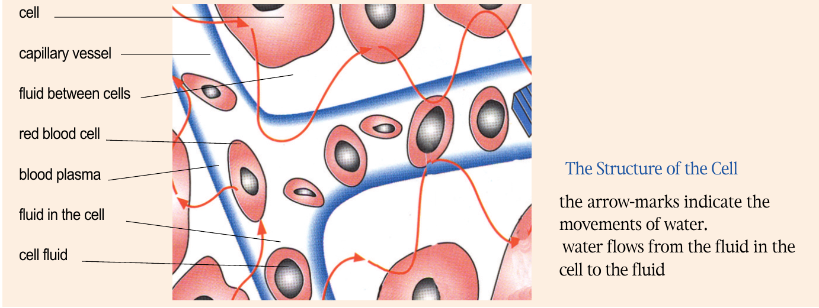
Functions Of Water
1. Functions Of Water In The body
Man is a Walking Water Bag ! More than 70% of the body consist of water. And 90% of the blood is made up of
Water. The blood consists of about 60 different unit cells and plays the very important role to supply the
necessary substances, including minerals, nutrients & oxygen for the proper metabolism by the cells. The
blood can also play a role to discharge the waste leftovers, made after the metabolism by sending them to
Kidney, Lung or Large Intestine. Water in the blood, therefore, works to supply the necessary nutrients and
also to discharge various leftover-wastes out of the body.
42

Slide 43
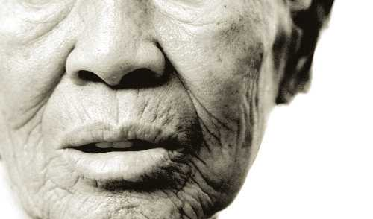
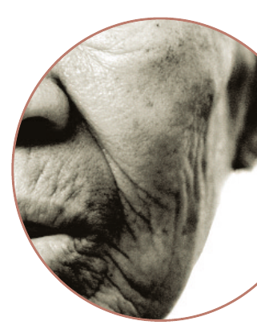
2. Aging And Water
When sperm meets the egg, 99% of the fertilized ovum is water and when a baby is
born, its body consists of 90% water. However, when a baby is grown up, he or she
loses nearly 20% of that 90%water and loses up to another 40% of it, when he or
she becomes elderly. The aging process can be expressed as the process of
losing water. A well known Korean Professor, Chun, Moo-sik, who’s referred
to
as Mr. Water in Korea, said “Aging is the process of losing water,” adding that
in losing only one or two percent of body water can cause severe thirst with
pain and losing nearly 12% of it can jeopardize human life. Every living cell
leaves wastes. The nutrients we take in are delivered to the cells where they are
burned, and combined with oxygen. This burning of nutrients leaves wastes.
Almost all cells in the body last up to 4 weeks, then go through the process of
metabolism which leaves behind dead cells that are acidic. Polluted air, water, ultra-violet rays,
preservatives, agricultural chemicals, pesticides & many other harmful substances in our environment can
kill more cells than normal metabolism would, leaving more acidic wastes. When these wastes cannot be
properly discharged, they become solidified, and accumulate somewhere in the body. When there is a
build-up in the pancreas, it causes diabetes and when accumulated in the blood, it leads to high blood
pressure, due to hardening of the artery. I If it accumulates in the kidney, a stone can form in the bladder
and when it accumulates in the joints, it ends up causing gout.
Therefore, depending on where the wastes build up, you can identify the diseases it will cause.
43

Slide 44
The water we drink daily can play an important role in discharging acidic body waste. Not all water can
play the role of catalyst in discharging body waste. Only Alkaline Reduced Water can do that. Just as we
wash the skin of accumulated acidic waste by using soap, we ought to wash the acidic wastes from our bodies
by drinking Alkaline Reduced Water. Environmental pollution and diet patterns often geared to fast foods
cause the major changes in our body that results in acidification. Daily intakes of at least 12 glasses of
Alkaline Ionized Water can play an important role in improving body health and maintaining a well-
balanced metabolism.
44

Slide 45
With respect to the foods we take in daily, it is important to classify food as Alkaline or Acidic, after it is
broken down inside the body.
Acidic Foods : foods rich in Sulfur, Phosphorous, Chlorine
(1) Kinds : Cheese, Egg Yolk, Fish, Meats, Nuts, Asparagus, Spring Onion, Grains, Beer & Gin
(2) High Acidic Foods : Egg Yolk, Poultry, Sea Bream, Squid, horse mackerel, oceanic bonito, rice bran, brown
rice.
(3) Weak Acidic Foods : Butter, Asparagus, Fried Bean Curd
(4) Acidification of body fluids by acidic food helps the Anti-bacterial and digestive activities both inside and
outside the body. However, it can also cause excessive Acidification in the body, accelerating Aging.
Alkaline Foods ; foods rich in Calcium, Potassium, Iron
(1) Kinds : Milk, Egg White, Tofu, French Bean, Vegetables, Sweet Potato, Fruits, Seaweed, Mushroom,
Wines, Brandy, Coffee & Green Tea
(2) High Alkaline Foods : Spinach, Shiitake Mushroom, Kidney Bean, Brown Seaweed & Kelp
(3) Weak Alkaline Foods : Milk, Tofu, Breast Milk, Wines, Coffee
(4) Alkalinization of body fluids by alkaline food helps neutralize accumulated acidic wastes, preventing the
formation of various types of toxins within the body. I It also accelerates the alkalinization of the body, meaning
the rejuvenation of life.
46

Slide 46
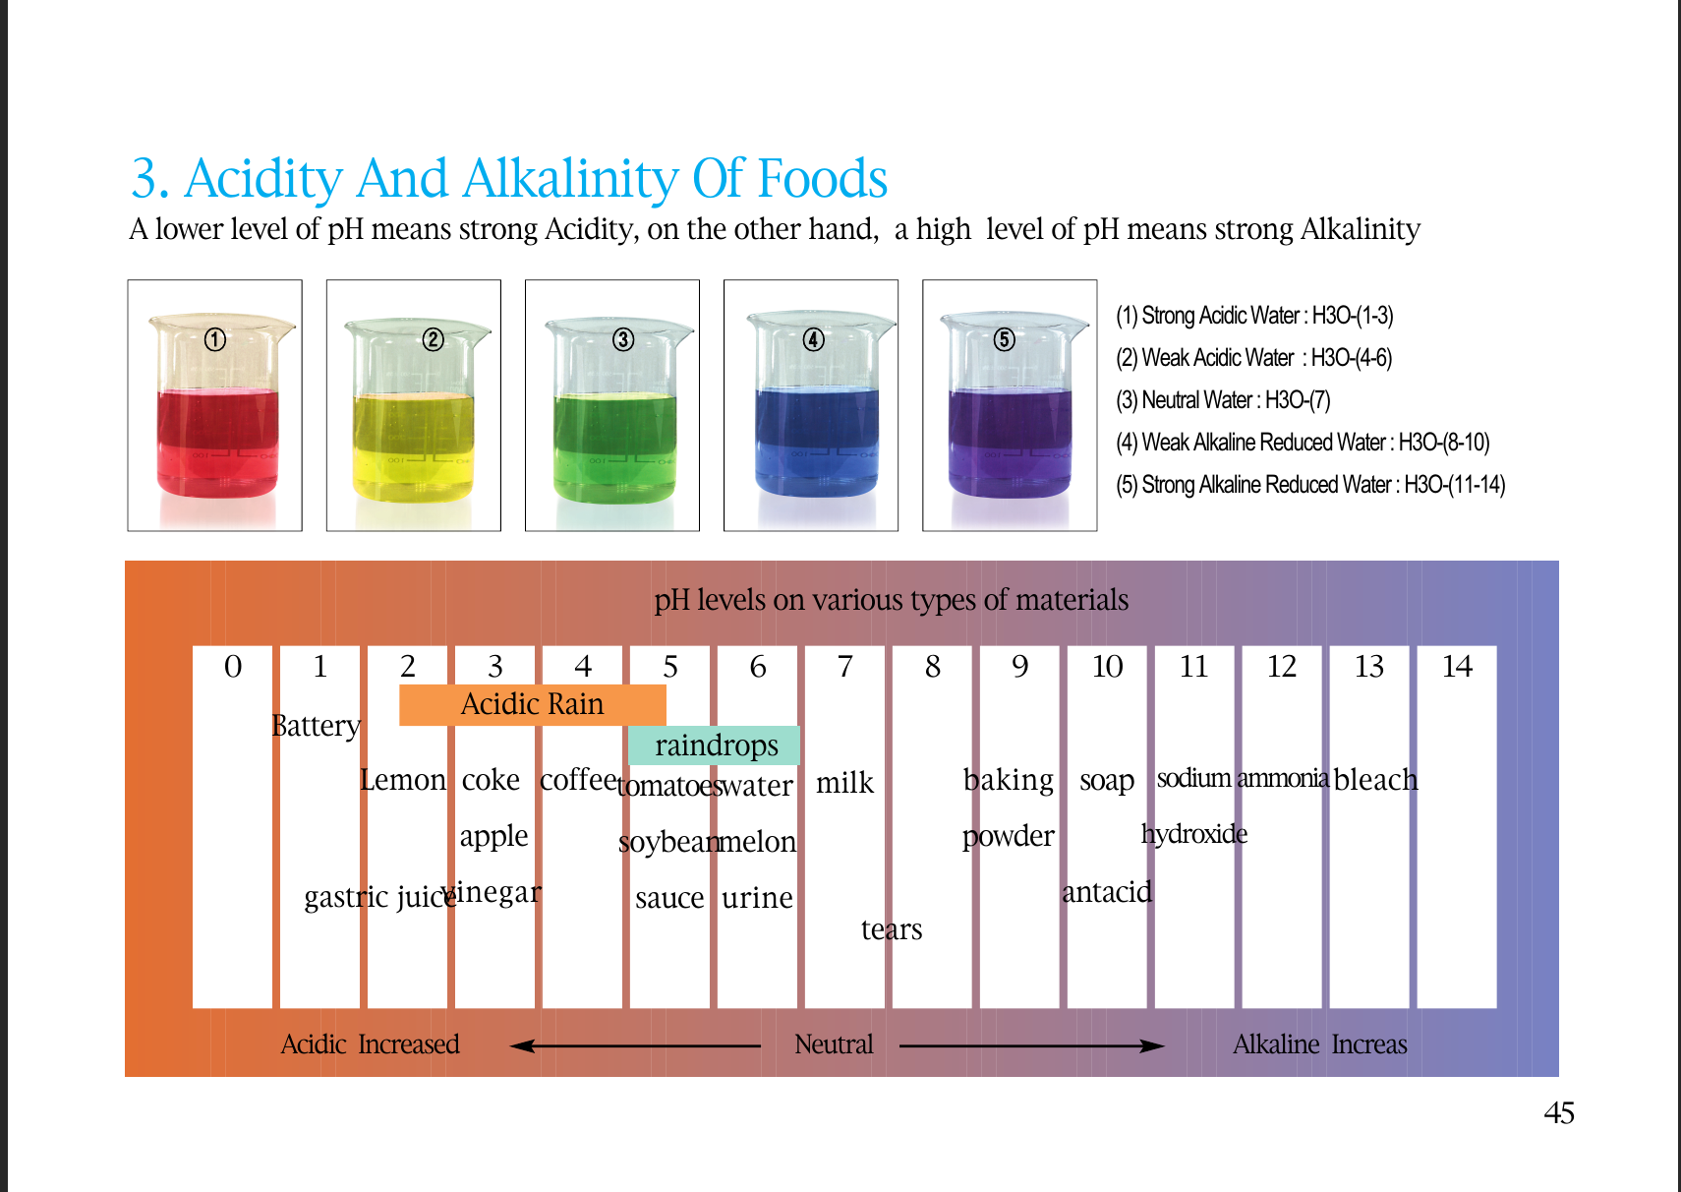
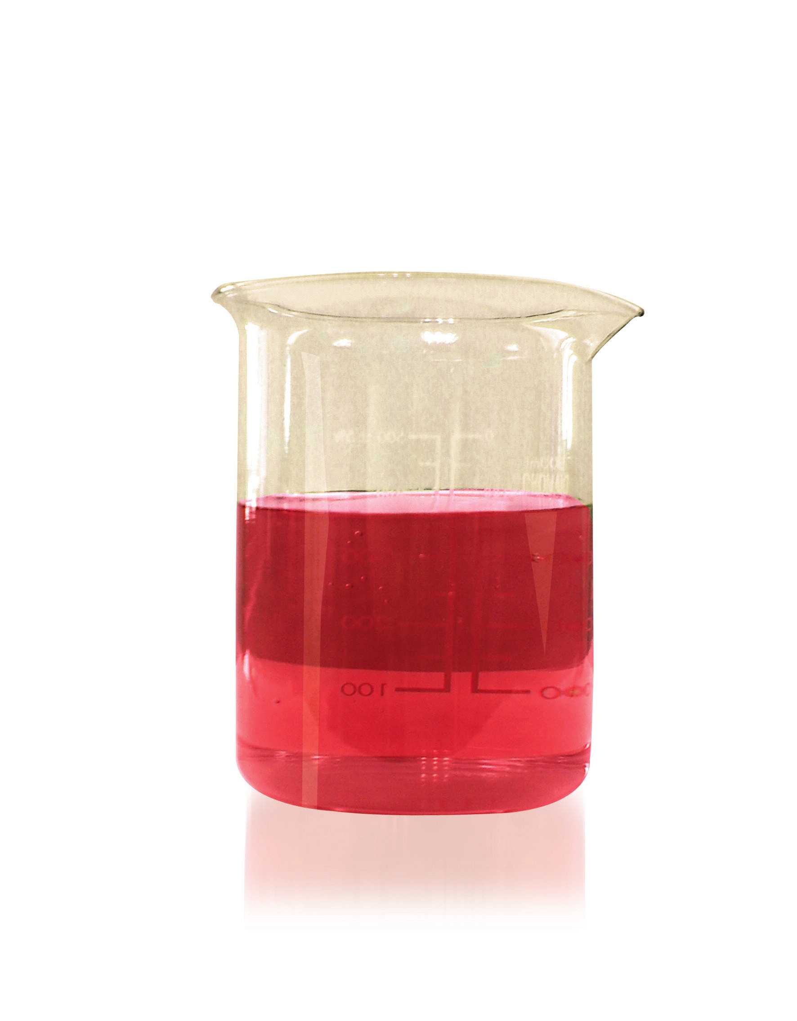
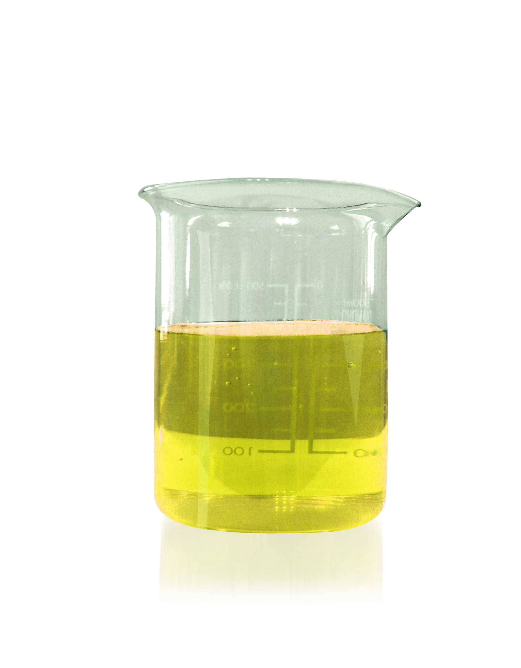
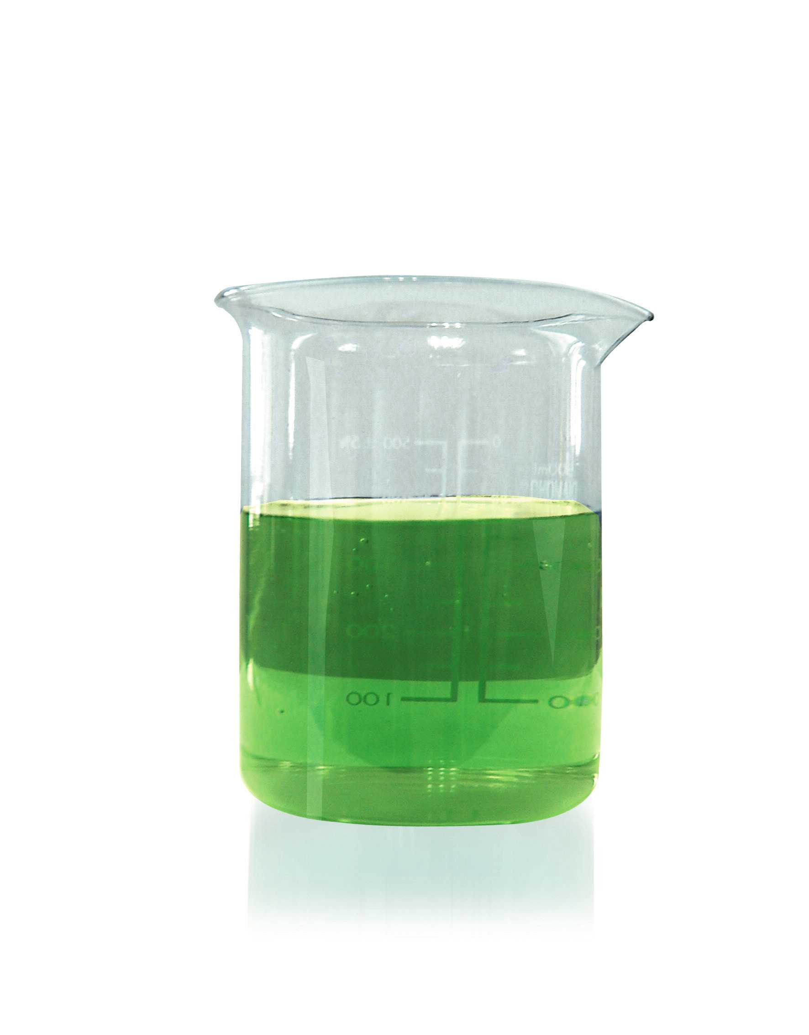
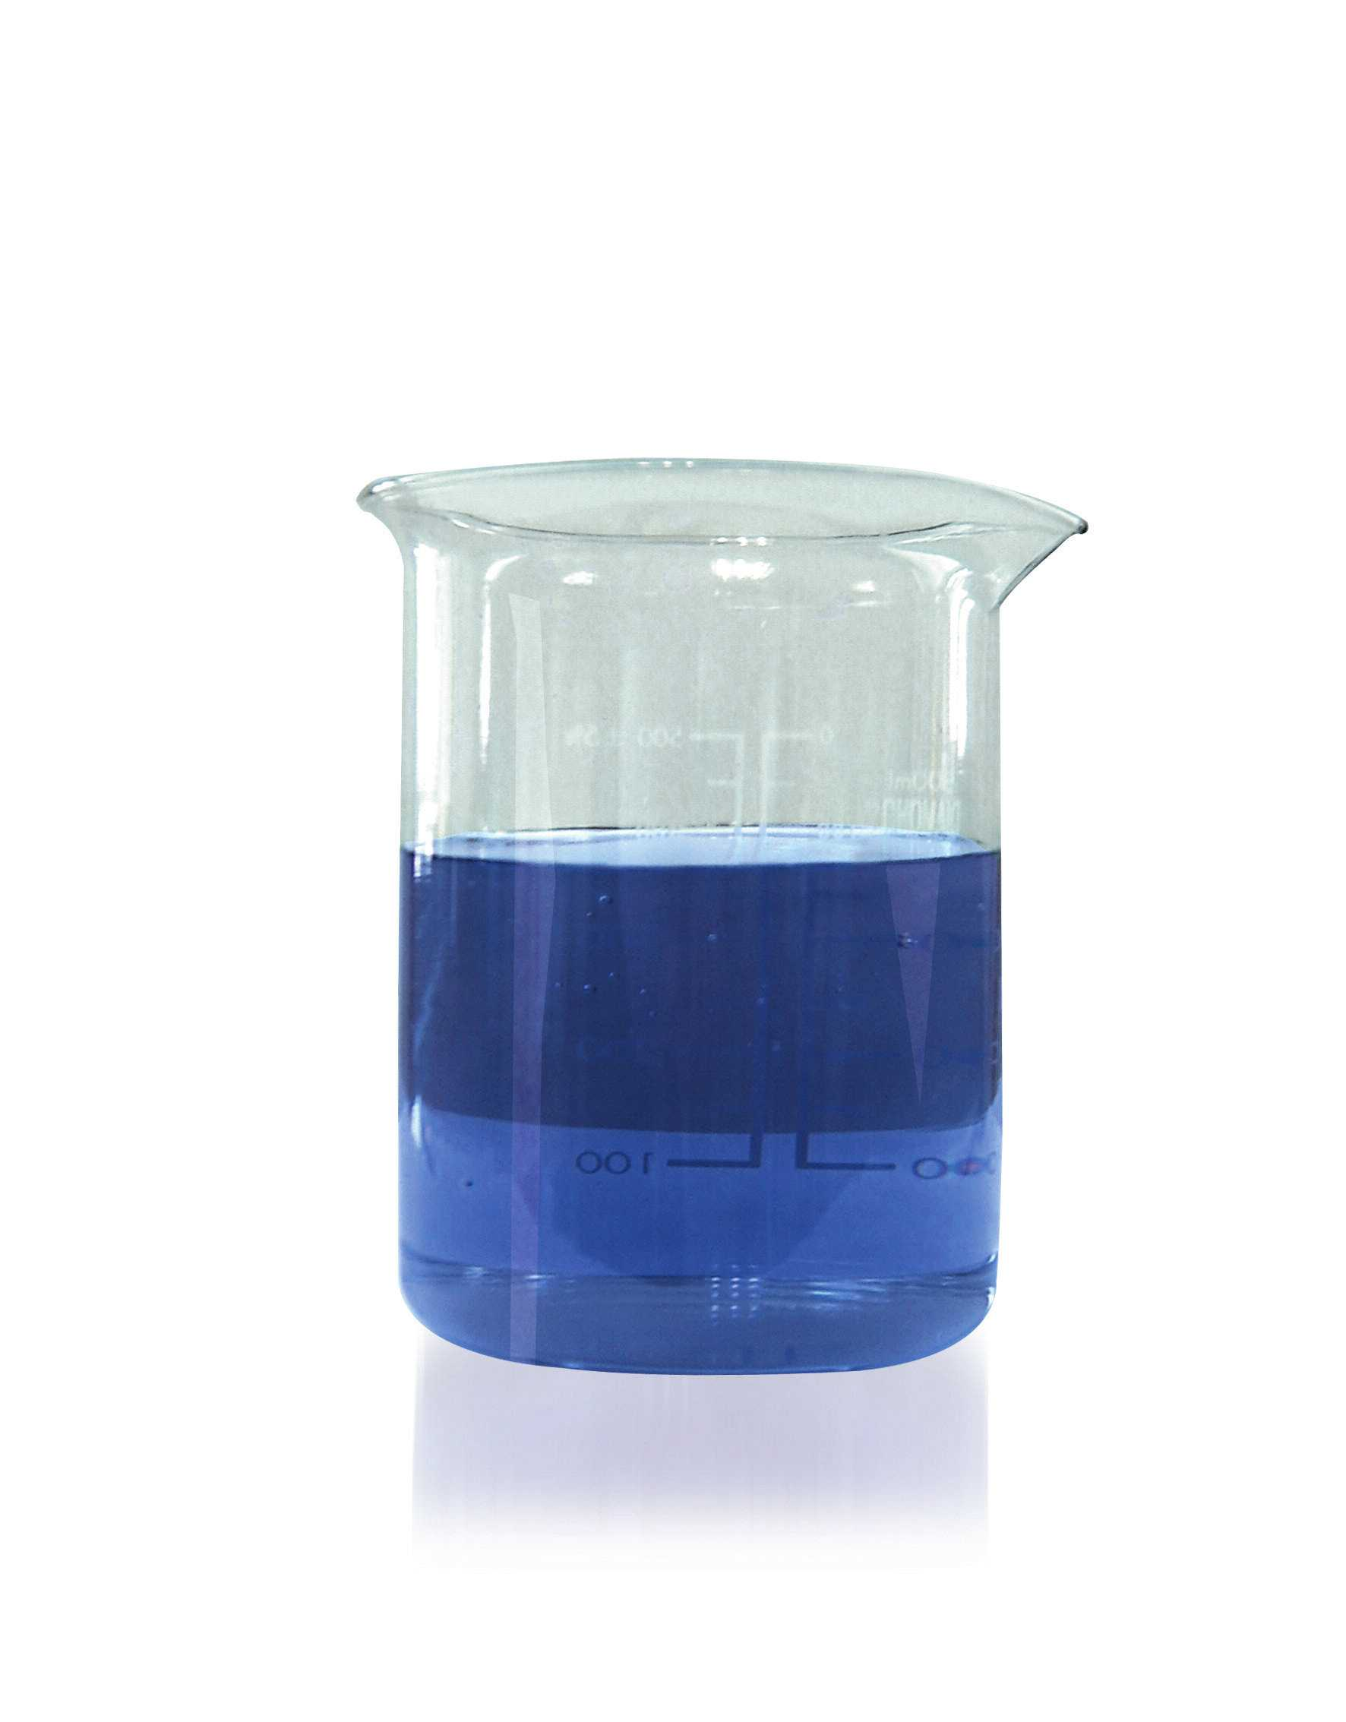
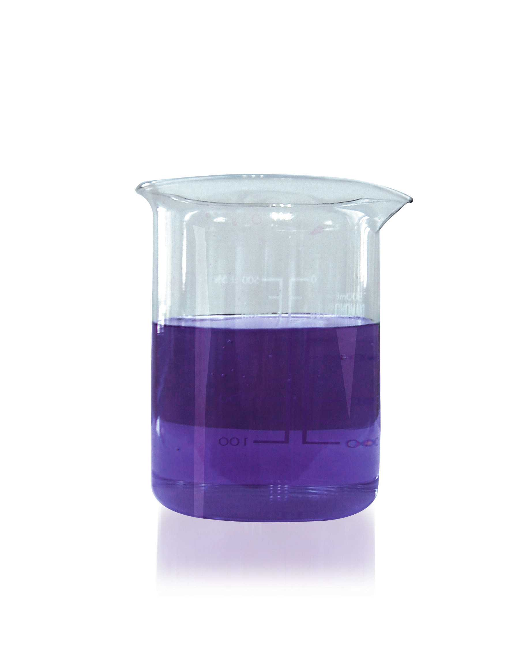
3. Acidity And Alkalinity Of Foods
A lower level of pH means strong Acidity, on the other hand, a high level of pH means strong Alkalinity
(1) Strong Acidic Water : H3O-(1-3)
(2) Weak Acidic Water : H3O-(4-6)
(3) Neutral Water : H3O-(7)
(4) Weak Alkaline Reduced Water : H3O-(8-10)
(5) Strong Alkaline Reduced Water : H3O-(11-14)
pH levels on various types of materials
01234567
Lemon
coke
apple
sauce
urine
milk
8
9
10
soap
antacid
11
sodium
12
13
14
Acidic Rain
raindrops
ammoniableach
hydroxide
tears
Acidic Increased Neutral Alkaline Increas
45

Slide 47
4. PreConditions For Good Water
- E Coli is the main cause of Diseases Spread By Water and should not be
found over the baseline figure for germs & bacterium
- Chemicals, Rust, Heavy Metals should not be found
- Calcium & other minerals should be dissolved in balance.
- pH range should be between pH8 and pH9.
- Water has to be cold. (it should be less than 20 ~25 degrees centigrade .)
- It has to be rich in Hydrogen Ions. (Or plenty of oxygen has to be
dissolved in the water.)
- Water taste must be good.
47

Slide 48
5. What Kind Of Water Are You Drinking Now?
Tap Water
It is treated with Chlorine to sterilize various types of pathogenic bacteria in the water. However, it can be harmful to
the body, due to the Chlorine Residue left, behind in the tap water. To make matters worse, water contaminated by
germs from rusty water pipes poses a threat to our health.
Boiled Water
When water is boiled, various germs & bacteria are destroyed, but at the same time, what”s beneficial to the body can
also be destroyed. Therefore, boiled water can be described”dead water.”
Underground Water & Spring Water
Various types of waste waters, sewage & fertilizers contaminate the soil and underground water. And the acid rain from
various kinds of air pollutants can acidify the soil and n soak its way underground, compromising the water there as
well as the water between rock beds.
Reverse Osmosis Water
Various kinds of beneficial minerals, such as Calcium, Magnesium & Potassium in the water are filtered and removed.
The more RO water we drink, the higher risks we face of disease and illness, such as stroke or cardiovascular disease,
due to leaching valuable minerals out of our body like the teeth & bones.
Ionized Water
Tap water is filtered before it is electrolyzed into Alkaline Ionized Water and Acidic Ionized Water. Alkaline Ionized
Water helps neutralize the body constitution, scavenging Oxygen Free Radicals while balancing the body metabolism
more towards Alkalinity. Acidic Ionized Water can also be used for cleansing and sterilizing purposes.
48

Slide 49
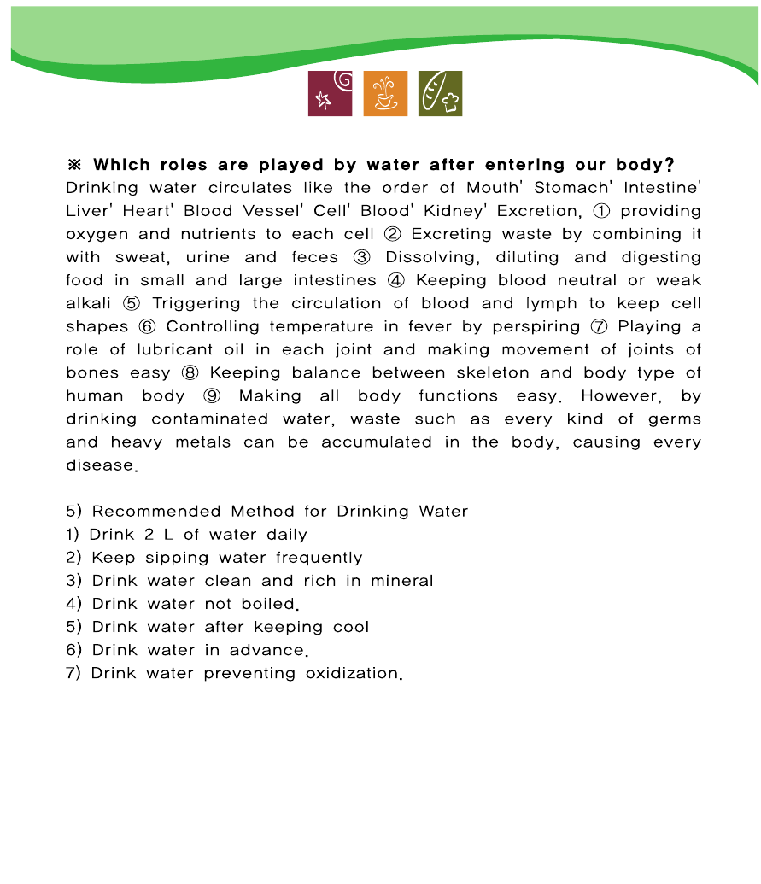

Slide 50
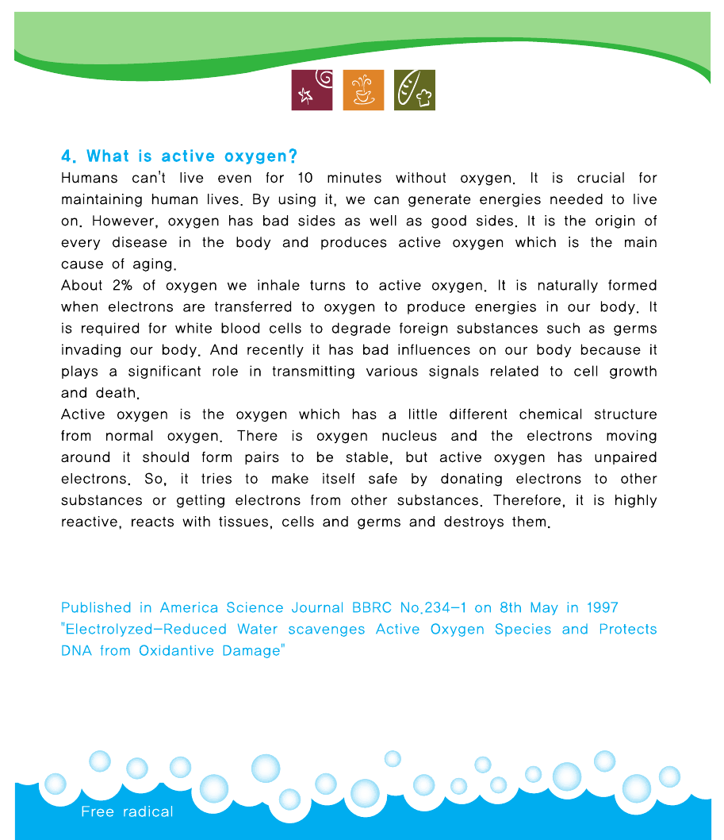

Slide 51
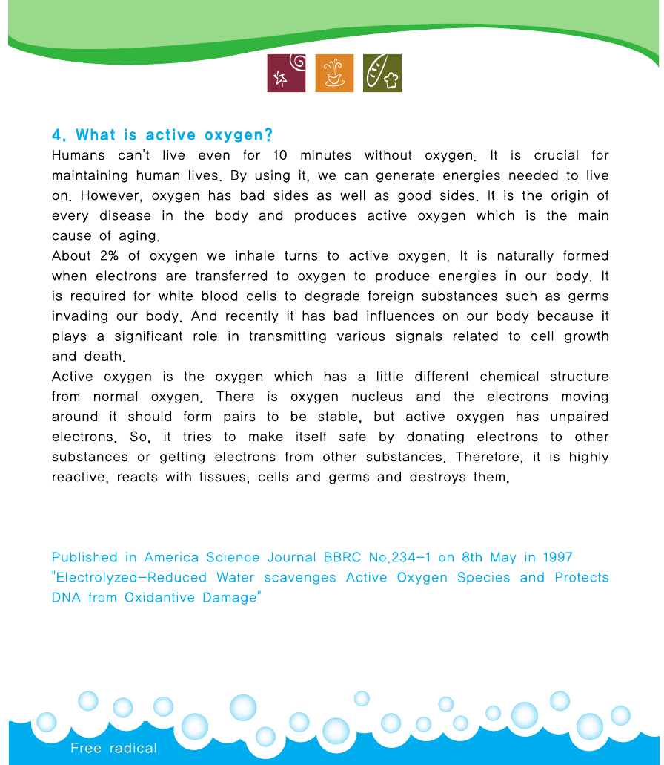

Slide 53
Electrolyzed Reduced
Alkaline Water
52

Slide 56
8. Functional Comparison Of Different Types Of Water
Boiled Water Water Taken from a Purifiedwater(reverse Alkaline water
mountain. osmosismethod)
Water size 111.6Hz 100Hz 150Hz 54Hz
Oxygen No Yes Yes Rich
Mineral Yes Small amount Not at all Rich
Sterilizing Power Good Not at all No Excellent
Absorbing Power Not very good Some Not very good Excellent
Medical benefit No No No(manufactured Excellent(Approved as a medical device)
products)
51

Slide 57
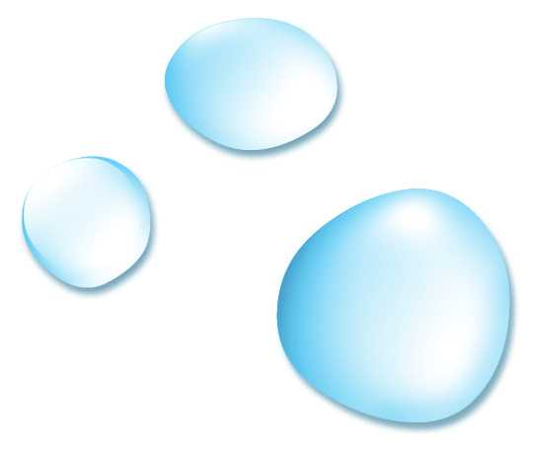
1. Electrolyzed Alkaline Water
- For Medical Purposes : It helps cure diseases, such as gastric disorders, diabetes, obesity, skin
trouble & allergic dermatitis.
- For Drinking: It enhances water taste with plenty of oxygen and minerals, such as Calcium,
Magnesium, Potassium & Sodium. It accelerates metabolism with its fast
Infiltration of body cells, helping to fight obesity & various
treat aging-related ailments.
- For Cooking: It helps remove the bitter & sour taste of vegetables.
53

Slide 58
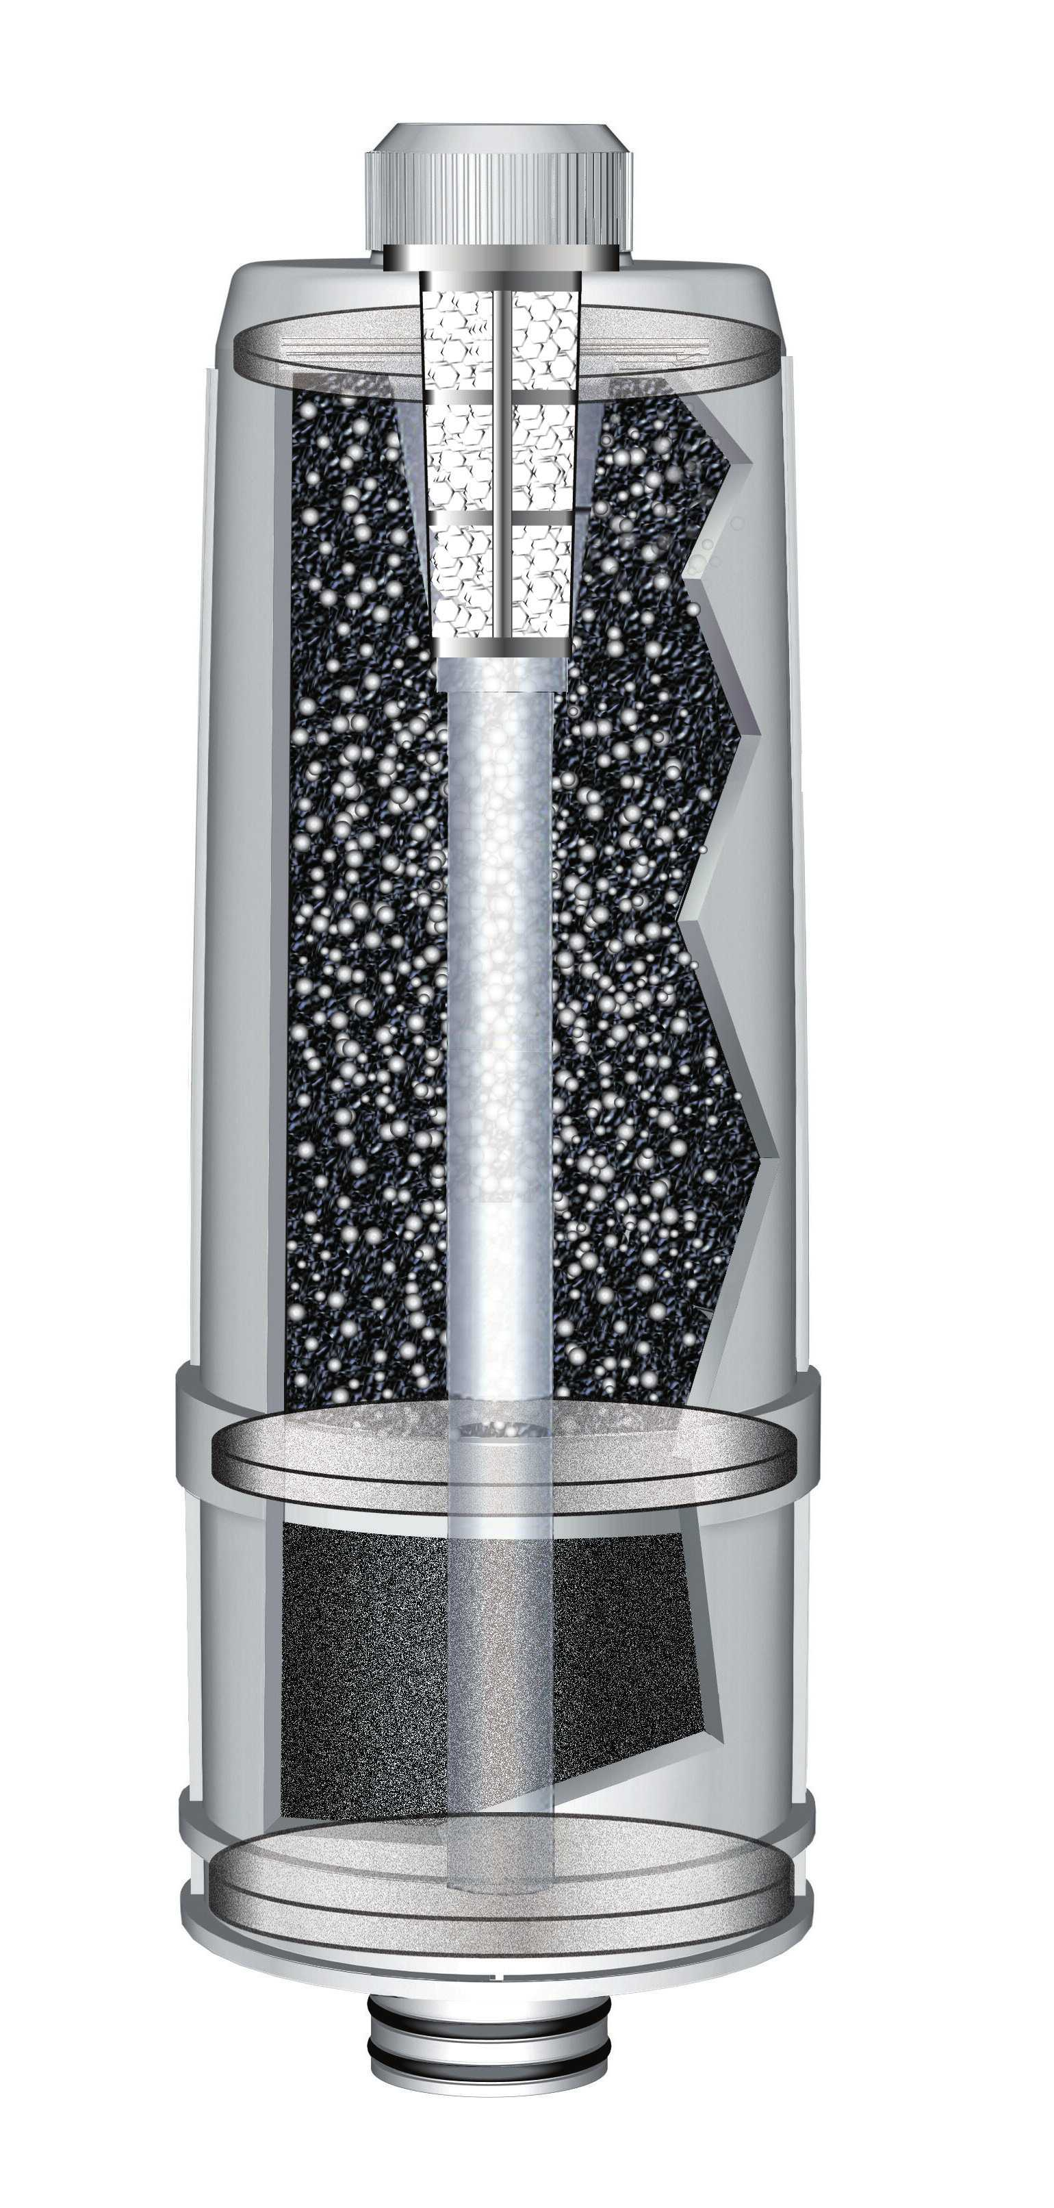
7. Main Compositions & Features Of The Filter
Silver-added activated carbon: Enhances sterilization performance, preventing
germ-proliferation inside the filter.
Granular activated carbon: Absorbs and removes various organic chemical
substances, including chlorine, fertilizer, carcinogens and water odor.
Calcium sulfite : Absorbs and neutralizes the unfiltered CL2, enhancing water taste.
PE Plane Filter : Filters any harmful foreign substances, inside the filter.
Bio-treatment : Sterilizes and breaks down the leftover-residues, removing odors
and preventing any secondary contamination, inside the filter.
Special Carbon Block Filter : Performs as Pre-filter, Activated Carbon Filter,
Silver-added Activated Carbon Filter, all at the same time.
50

Slide 59
- For Making Ice-tea with a Tea Bag : Experiment on the effects that Alkaline Ionized Water
has in terms of its filtration, solubility & absorption in a Green Tea.
RO Water Weak Alkaline Reduced Water Weak Alkaline Reduced Water Strong Alkaline Reduced Water
(pH4-5) (pH7-8) (pH8-9) (pH9-10)
Alkaline Reduced Water can infiltrate body cells faster than ordinary water due to its minimized water cluster.
- For Teas & Coffee : It helps remove bitter & sour taste, enriching their aromas.
- For Mixing With Whisky : It helps the taste, making it mild and smooth.
Astringent Effect of Acidic Ionized Wate
For Washing : It can be used for washing the face & hair, gargling, bathing and as an after-shave.
54

Slide 60
2.Main Causes For The Body Becomes Acidic
10% : Minor Factors
90% : Abnormal Enzymes Within The Stomach
90% Abnormal Enzymes
within the Stomach
(1) Breathing Oxygen (2) Stress (3) Smoking
(4) Drinking (5) Ultraviolet Rays, Radioactive Rays,
Electromagnetic Waves (6) Excessive Physical Exercise
(7) Smog, Combustion Gas (8) Germs, Virus Infection
(9) Administration of Anti-Cancer Medicine
(10) Raynaud’s Phenomenon, Poor Blood Circulation
Pre-Hepatic Organs Upstream / Post-Hepatic Organs
Downstream Theory
Oxygen Free Radicals or Carcinogens in the Hepatic
Downstream is the main
Factor, generating Cancers & all other diseases in the
Hepatic Upstream.
55

Slide 61
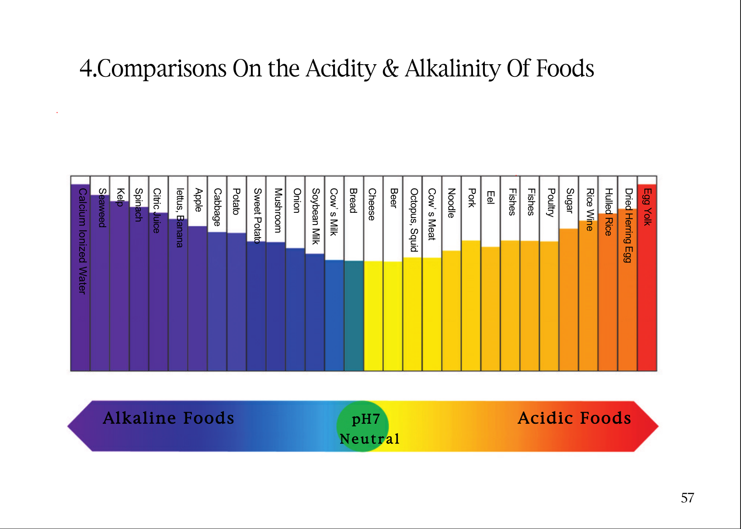
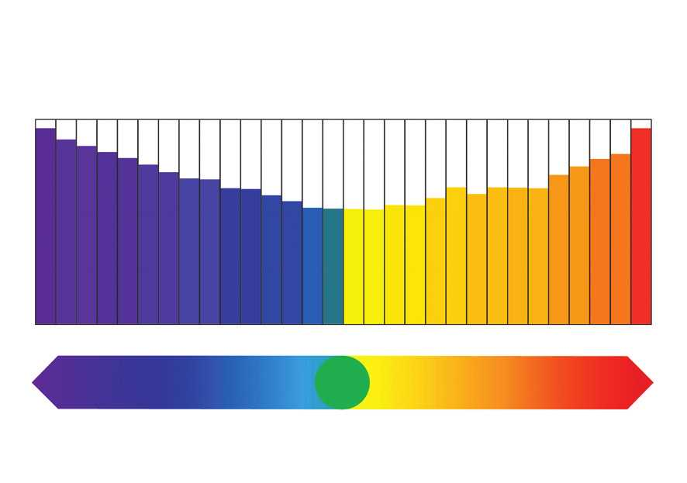
4.Comparisons On the Acidity & Alkalinity Of Foods
Calcium Ionized Water
Seaweed
Kelp
Spinach
Citric Juice
lettus, Banana
Apple
Cabbage
Potato
Sweet Potato
Mushroom
Onion
Soybean Milk
Cow’s Milk
Bread
Cheese
Beer
Octopus, Squid
Cow’s Meat
Noodle
Pork
Eel
Fishes
Fishes
Poultry
Sugar
Rice Wine
Hulled Rice
Dried Herring Egg
Egg Yolk
Alkaline Foods
pH7
Acidic Foods
Neutral
57

Slide 62
5.Changing Blood Colors & Blood Vessel
Acidic
Alkaline
Neutral
10.5 9.5 8.0 7.0 6.0 4.5 3.5 2.0
58

Slide 63
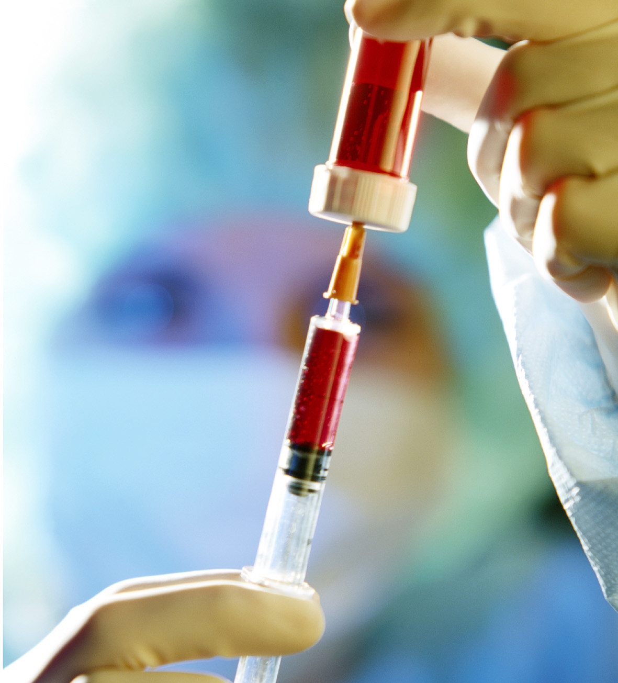
7.Progression Stages Acidification In The Body Constitution
Stage 1 (Blood
Contamination)
- dizziness, General
Fatigue, weakened
resistibility to ailments,
acidic waste
accumulates
Stage 2 (Excretion
Disorder)
- constipation, coarse
skin, gastric disorder,
diarrhea

Stage 3 (Weakened
Function of the
Intestines)
anemia, irregular
periods, mental
confusion
Stage 4 (Chronic
Disease)
Heart Disease, Liver
Trouble, Kidney Disease,
High Blood Pressure,
Diabetes, Gastric ulcer,
Cancer & Allergies
60

Slide 64
8.Main Causes, Leading The Body Constitution To Acidification
Lack of
Physical
Exercise
Stress
Contaminated
Environment
(water, air)
air pollutants
Increased Intake of Acidic Foods
(meats, squid, shell-fish, egg-yolk, liquor,
sugar, flour & food-additives)
Acidic Body Constitution => Various types of Aging-related Ailments
Diseases : High Blood Pressure, Diabetes, Poor Blood Circulation

Improved Body Constitution(Drinking Alkaline Reduced Water)

Maintaining Weak Alkaline Body Constitution

Enjoy every minute of Longevity
61

Slide 66
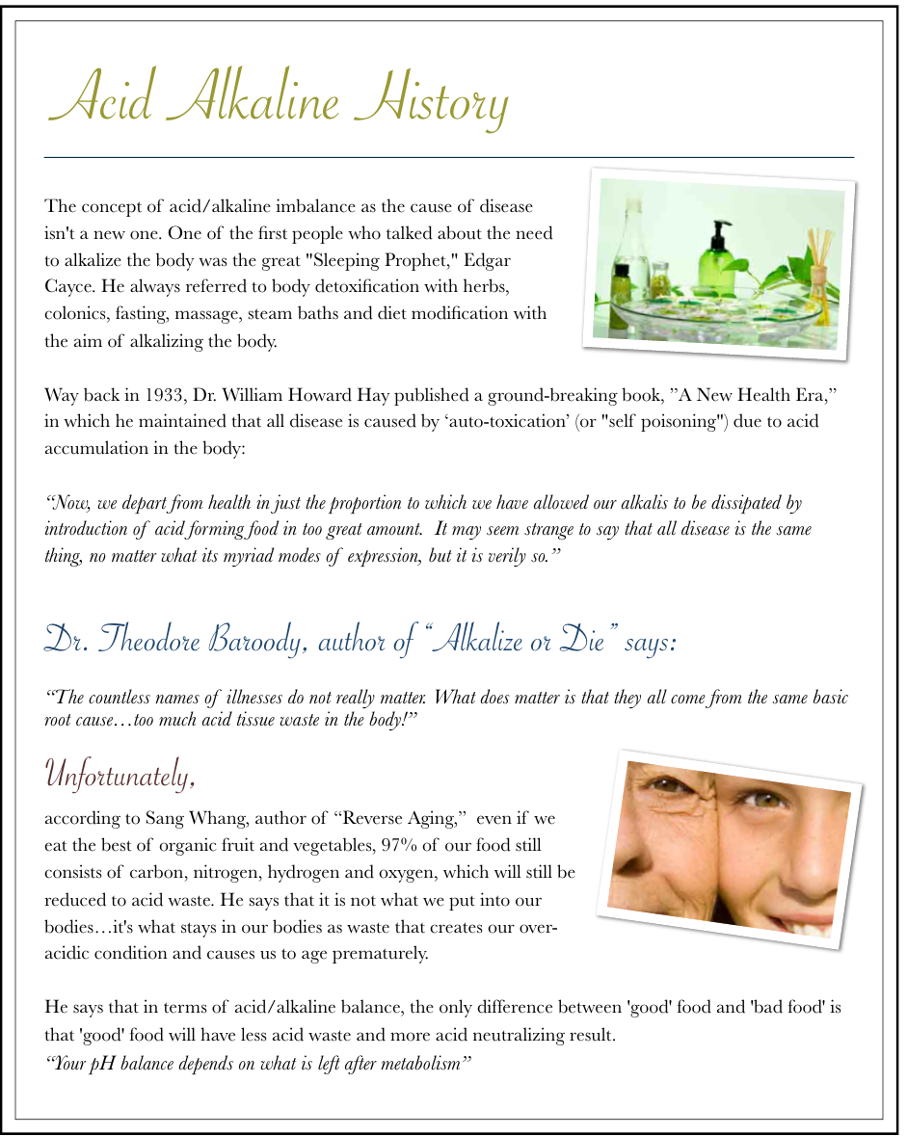

Slide 67
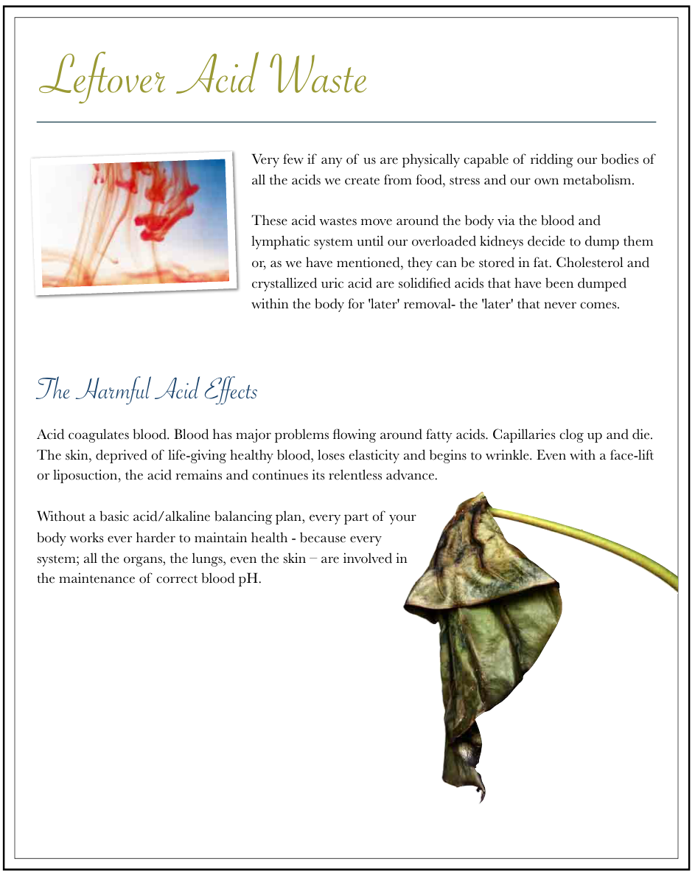

Slide 68
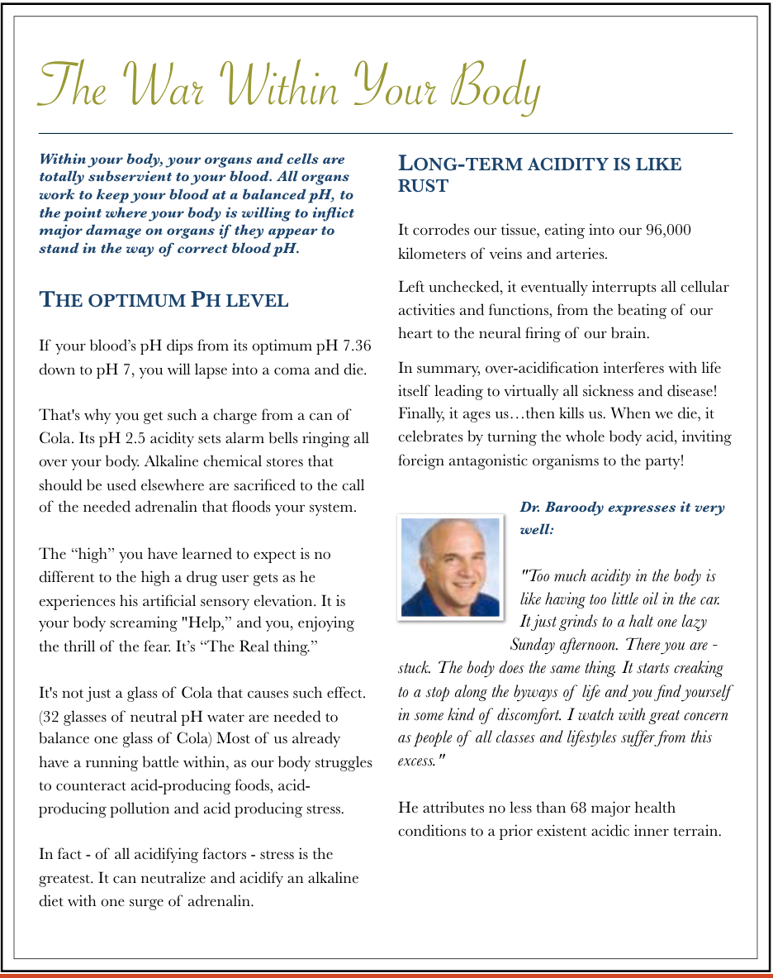

Slide 69
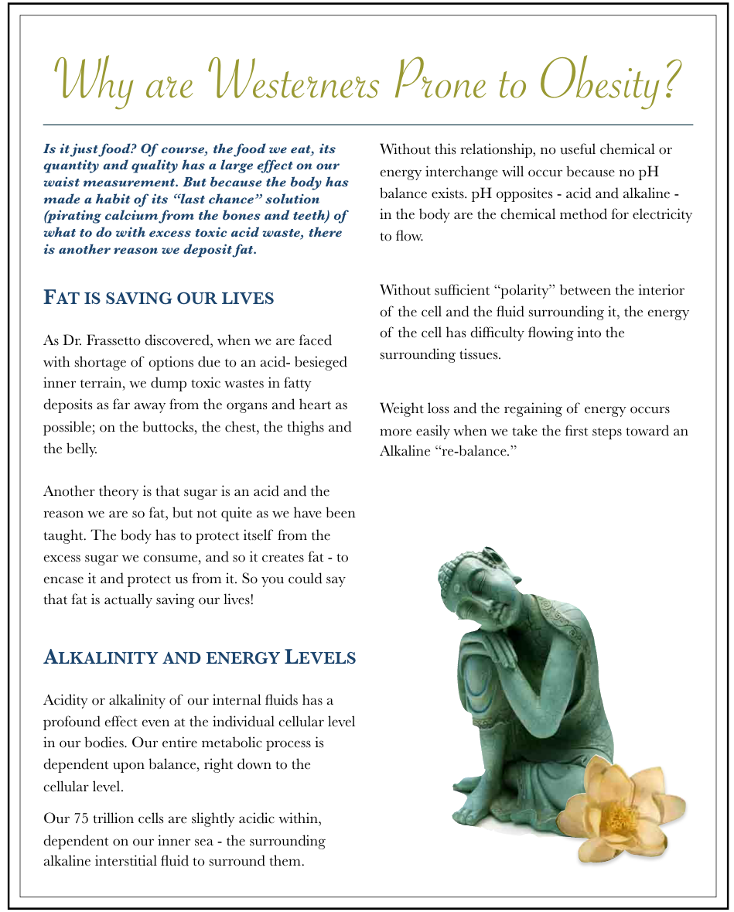

Slide 70
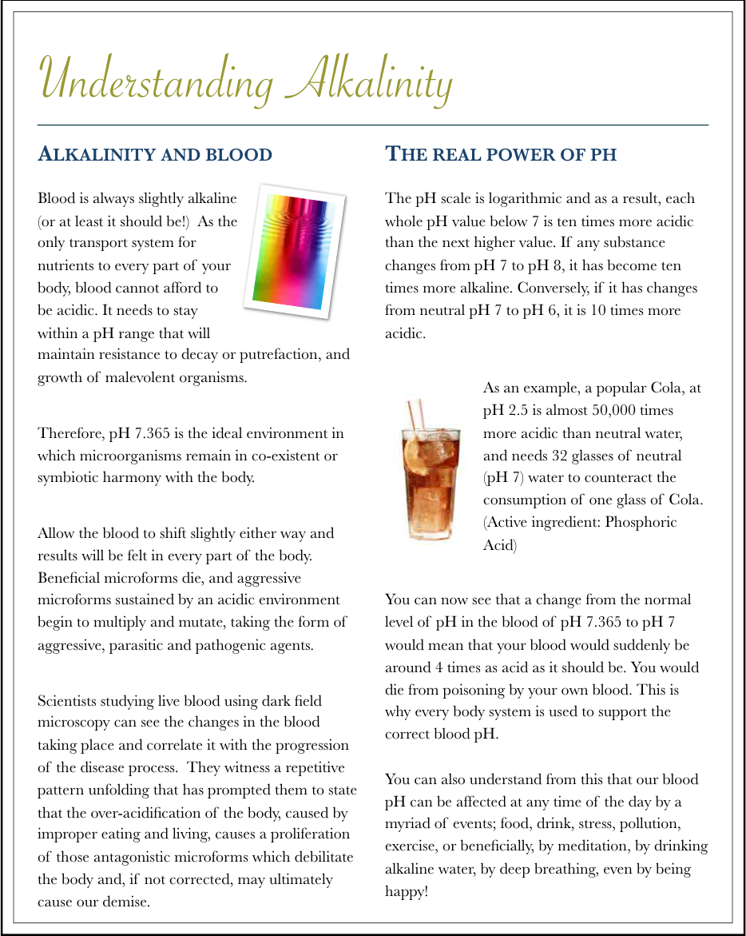

Slide 71
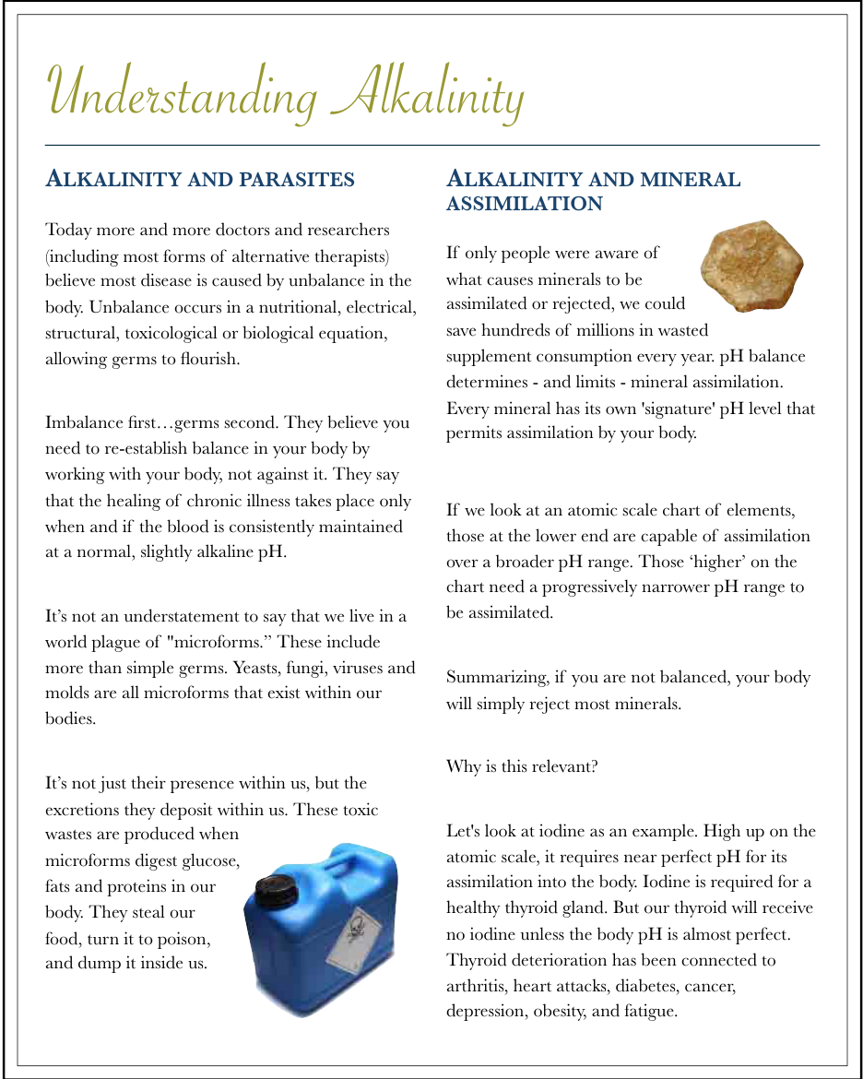

Slide 72
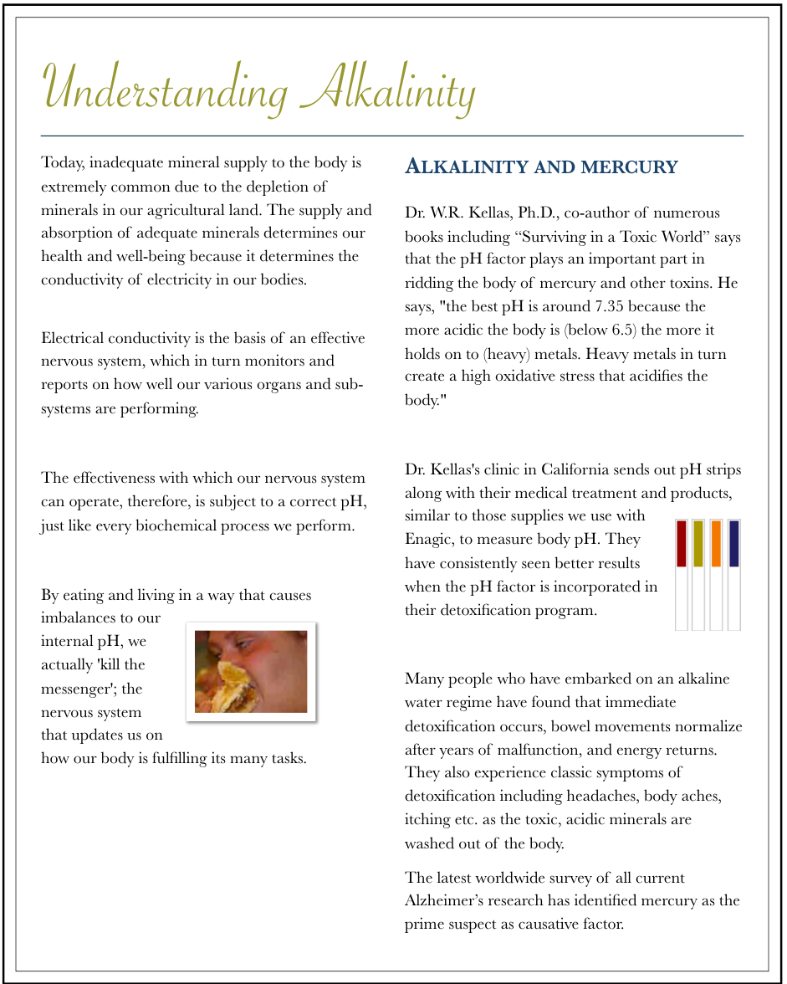

Slide 73
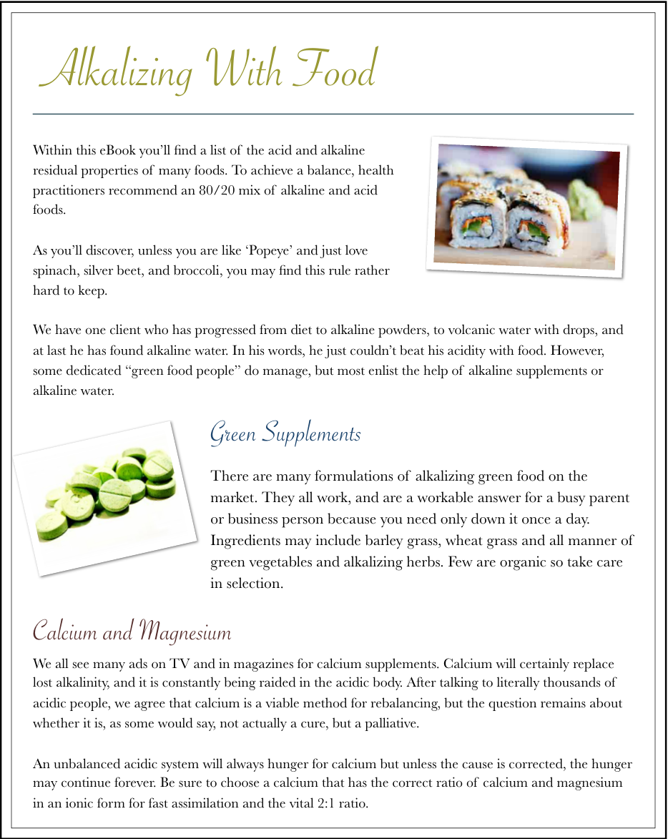

Slide 74
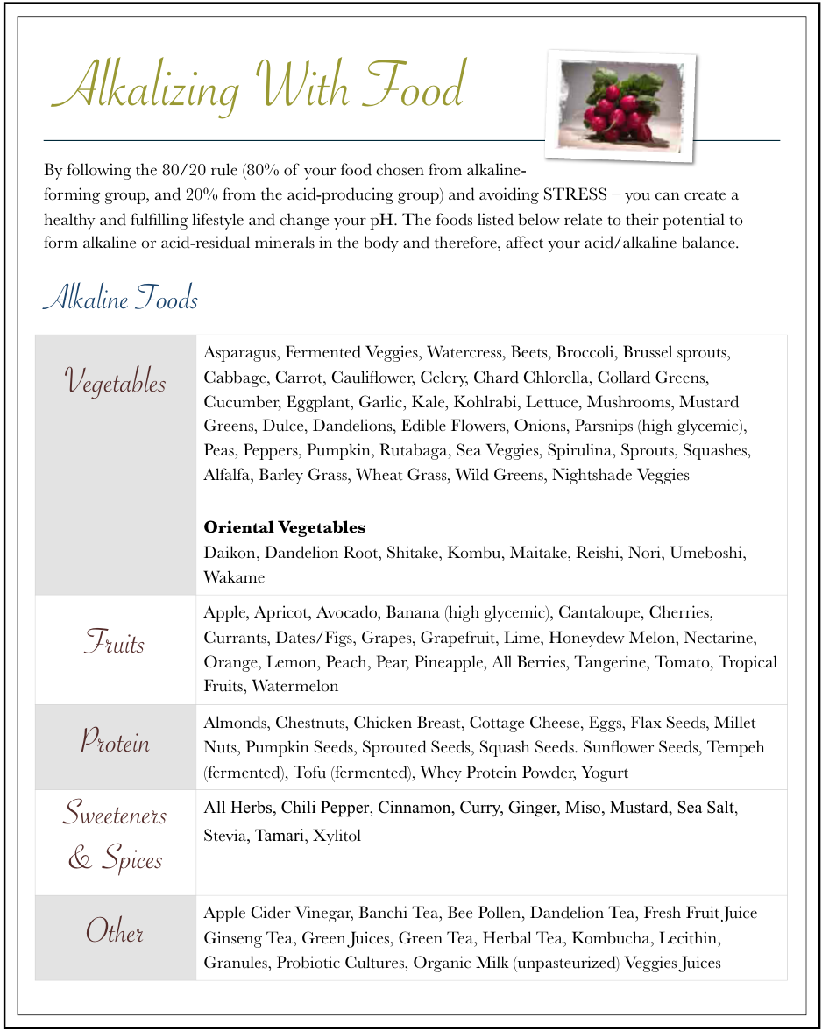

Slide 76
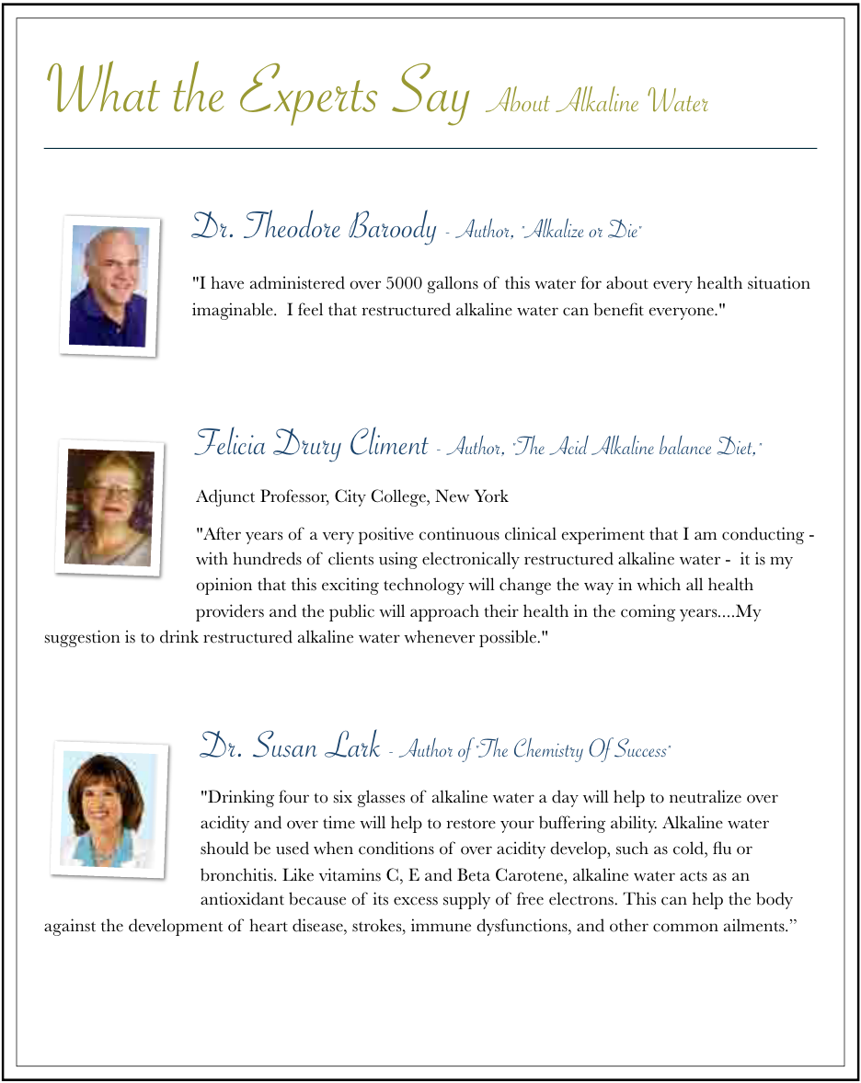

Slide 77
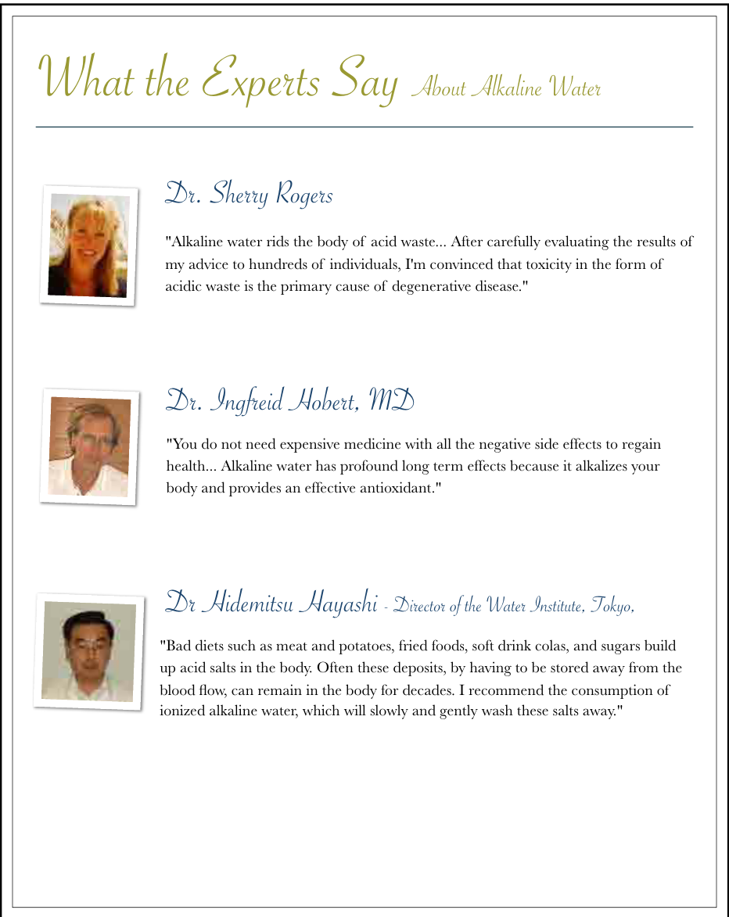

Slide 78
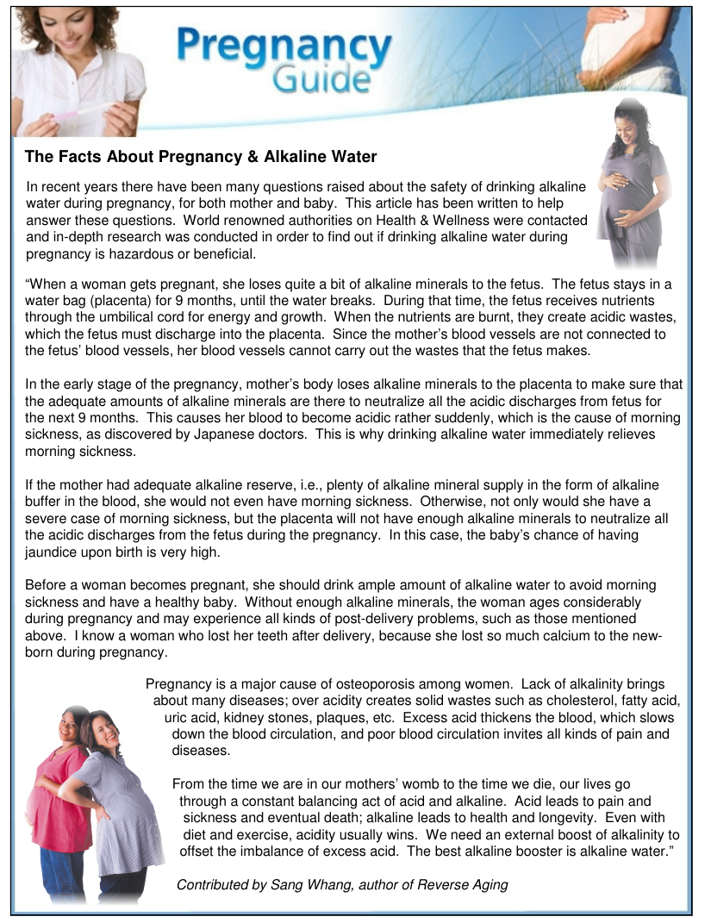

Slide 79
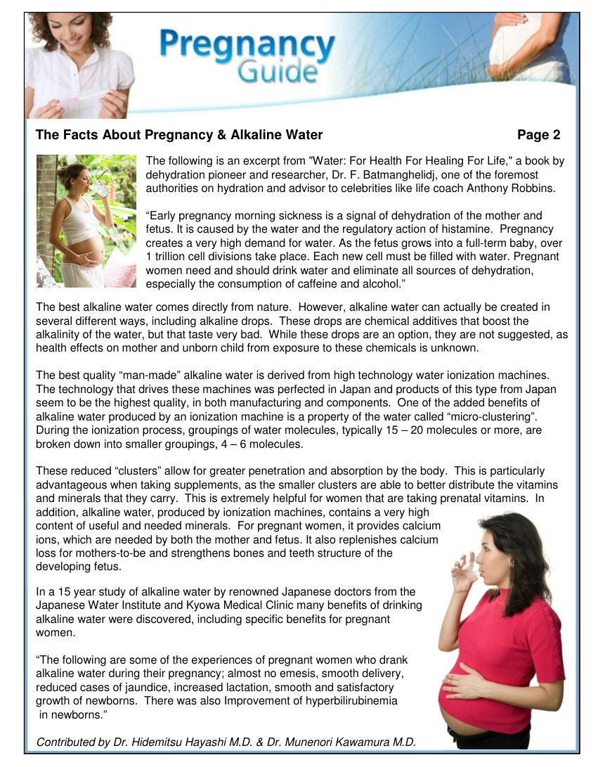

Slide 80
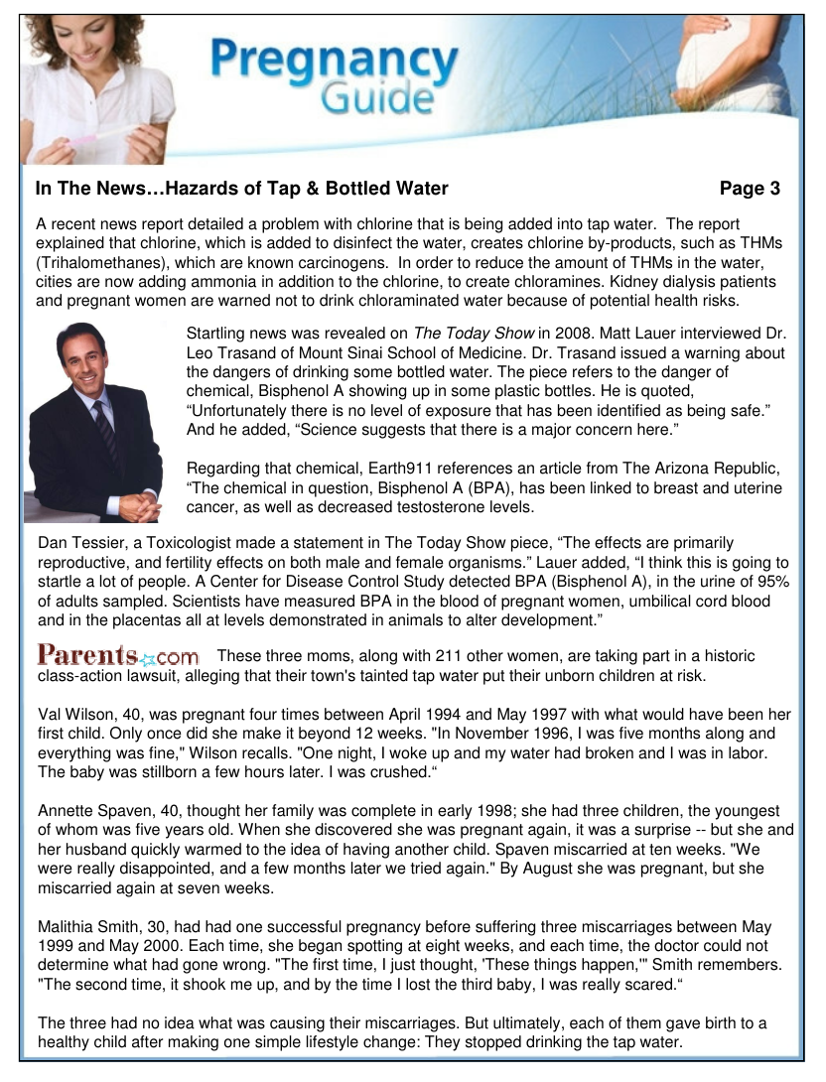

Slide 81
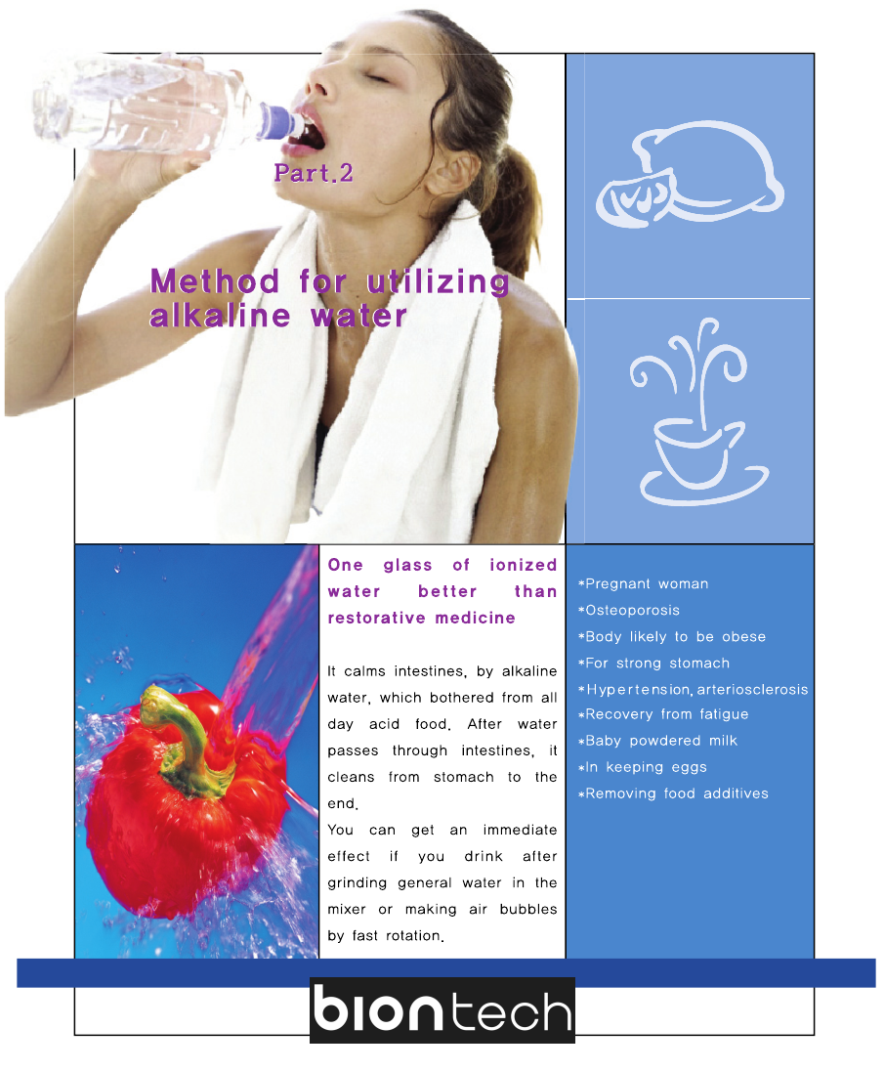

Slide 82
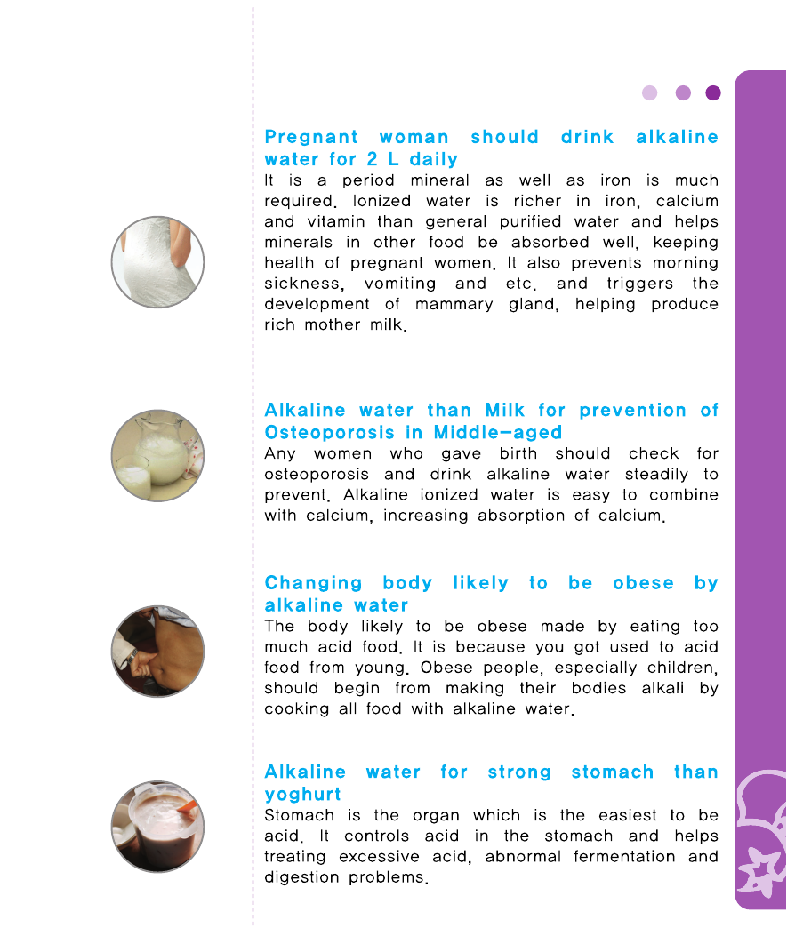
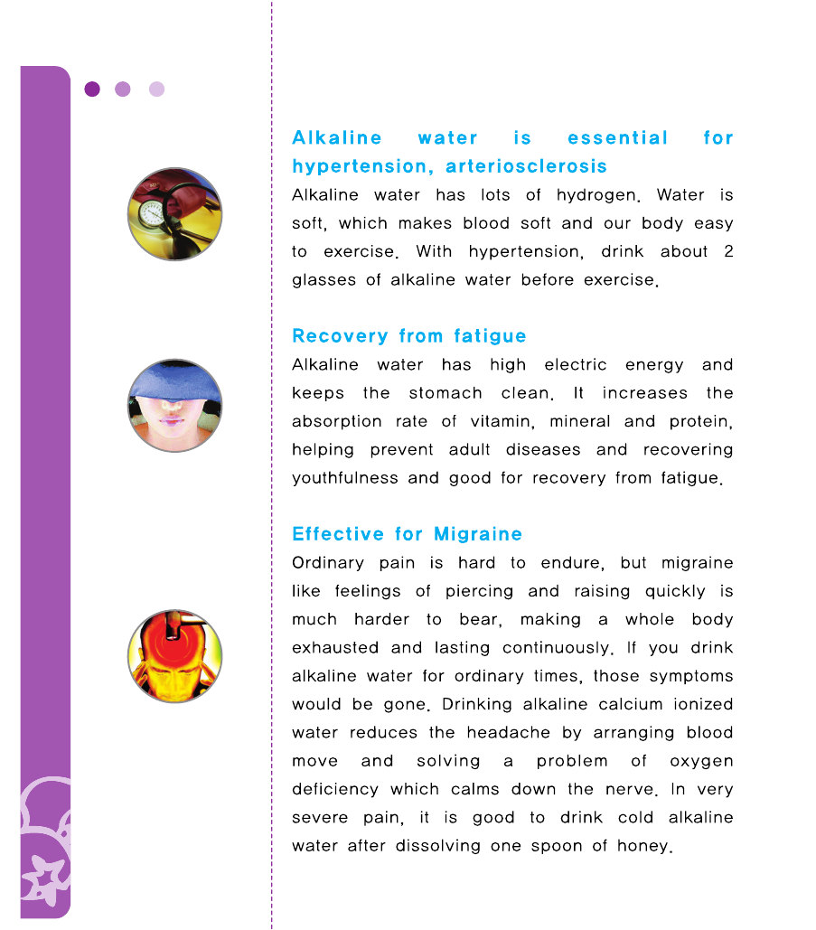

Slide 83
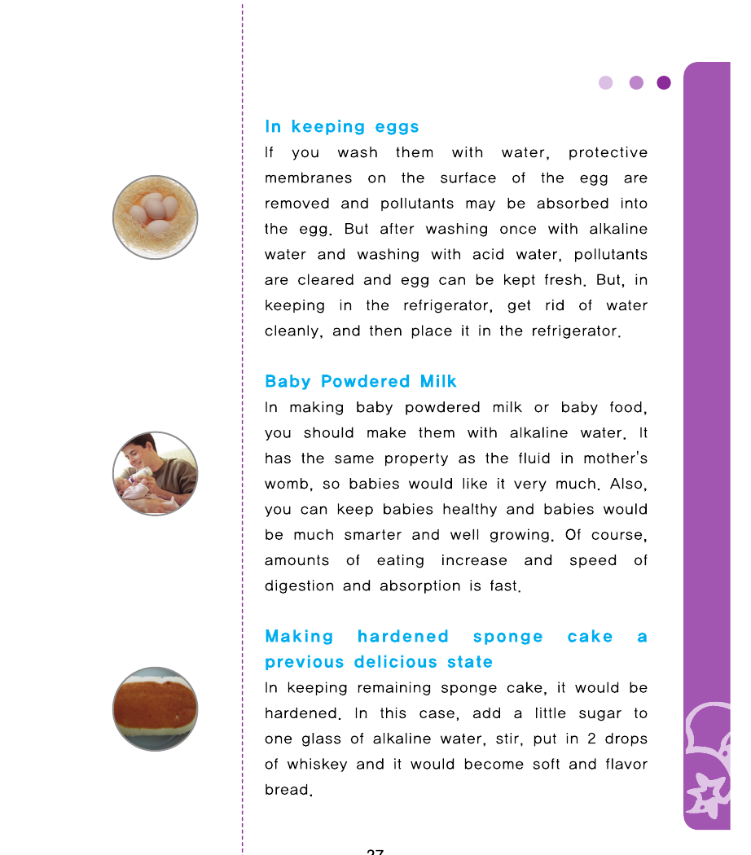
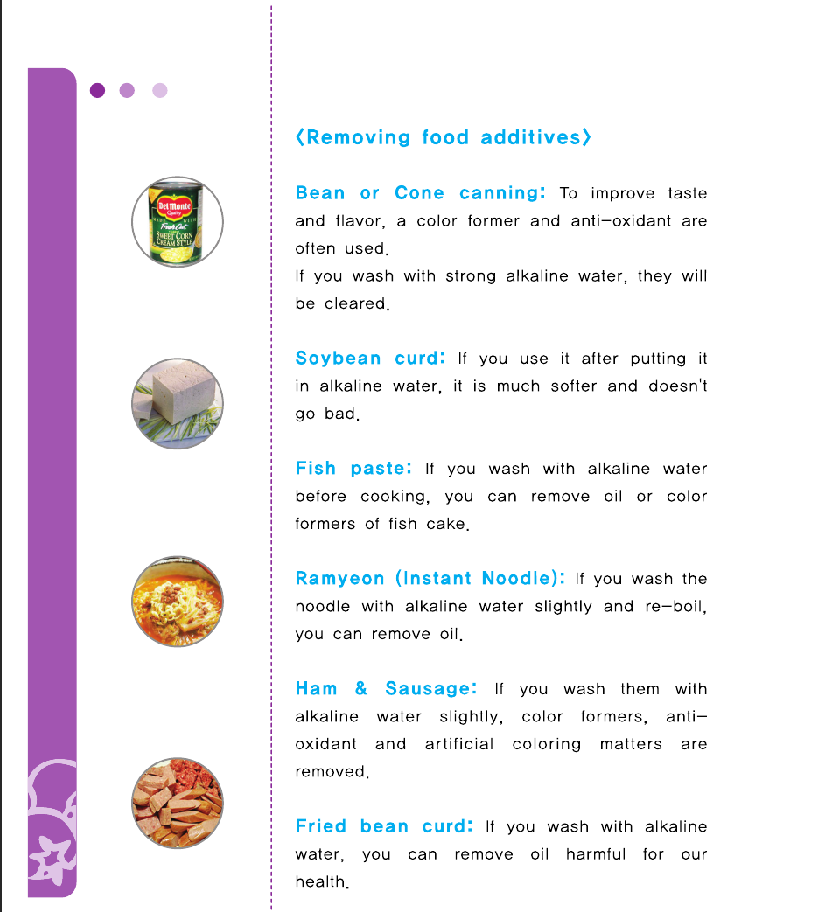

Slide 84
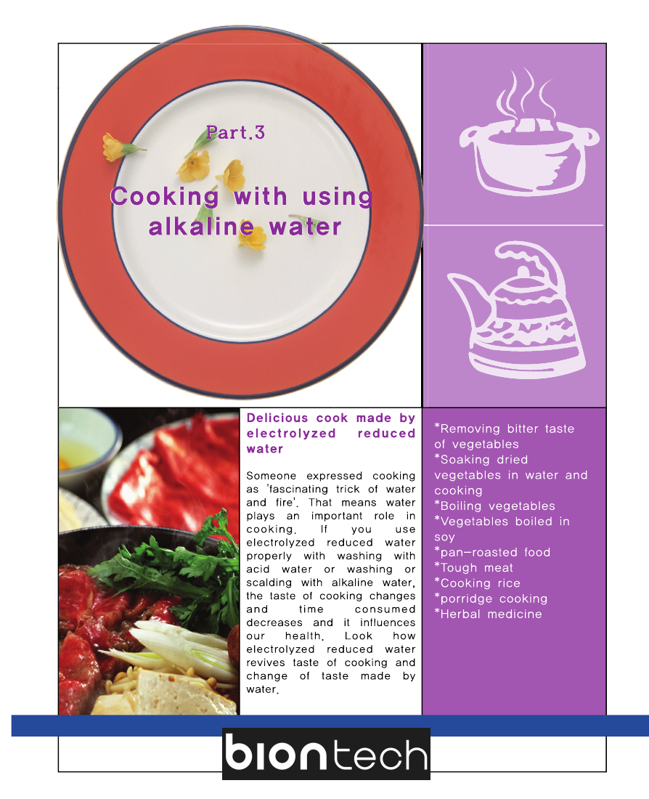

Slide 85
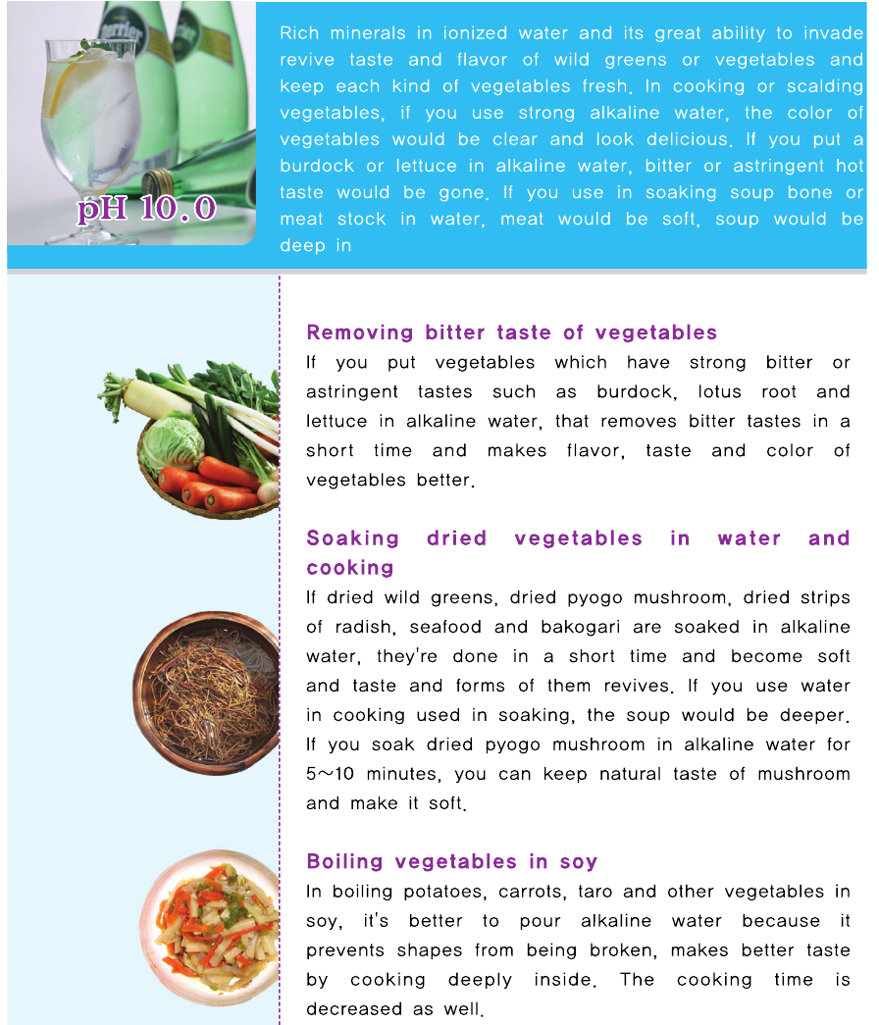
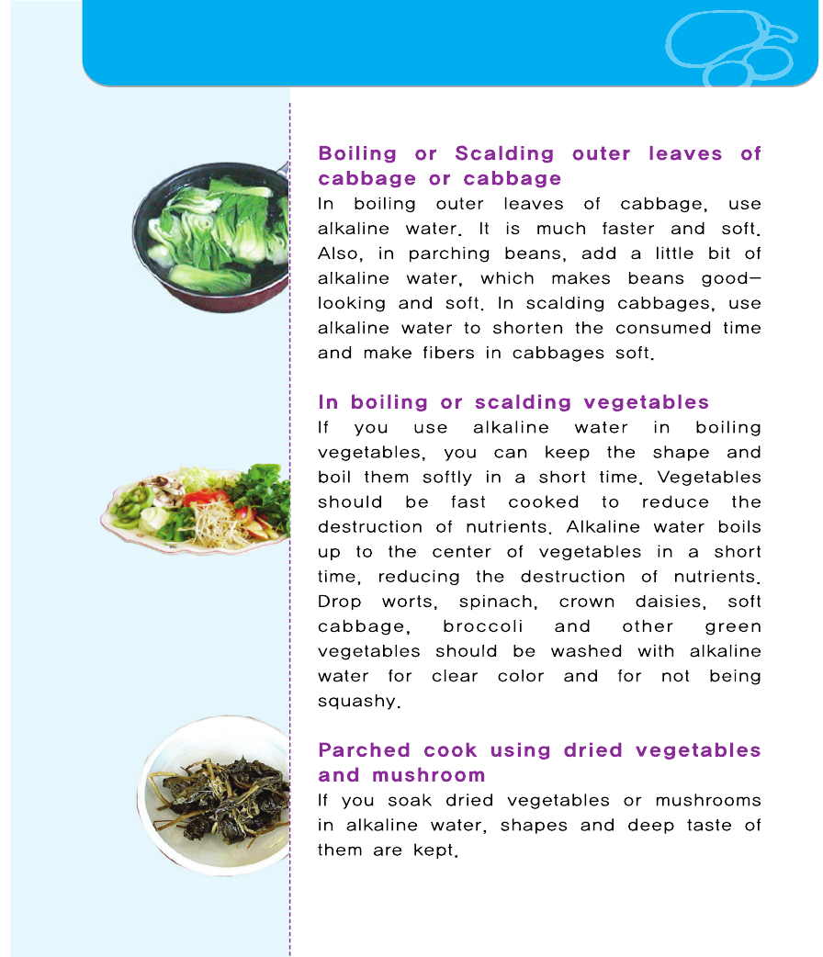

Slide 97
STUDIES OVER IONIZED,
ALKALINE WATER & HYDROGEN GAS
TABLE OF CONTENTS:
▪ Antioxidant Studies
▪ Bones Studies
▪ Brain Studies
▪ Cancer Studies
▪ Eye & Ear Studies
▪ Heart Studies
▪ Human Studies
▪ Hydrogen Gas Chemistry & Physics
▪ Hydrogen Gas from Bacteria Studies
▪ Hydrogen Gas Review Articles
▪ Ischemia/Reperfusion Injury Studies
▪ Kidney Studies
▪ Liver Studies
▪ Lung & Other Organ Studies
▪ Metabolic Syndrome Studies
▪ Pain Studies
▪ Plant Studies
▪ Safety Studies
▪ Sepsis, Gastritis, Intestine Studies
▪ Skin and Radiation Studies
▪ Spine & Pancreas Studies

Slide 98
Antioxidant Studies
1.Akhavan, O., et al., Hydrogen-rich water for green reduction of graphene oxide
suspensions. International Journal of Hydrogen Energy, 2015. 40(16): p. 5553-5560.
2.Berjak, P., et al., Cathodic amelioration of the adverse effects of oxidative stress accompanying
procedures necessary for cryopreservation of embryonic axes of recalcitrant-seeded species. Seed
Science Research, 2011.21(3): p. 187-203.
3.Hanaoka, K., Antioxidant effects of reduced water produced by electrolysis of sodium chloride
solutions. Journal of Applied Electrochemistry, 2001. 31(12): p. 1307-1313.
4.Hanaoka, K., et al., The mechanism of the enhanced antioxidant effects against superoxide anion
radicals of reduced water produced by electrolysis. Biophysical Chemistry, 2004. 107(1): p. 71-82.
5.Hiraoka, A., et al., In Vitro Physicochemical Properties of Neutral Aqueous Solution Systems
(Water Products as Drinks) Containing Hydrogen Gas, 2-Carboxyethyl Germanium Sesquioxide, and
Platinum Nanocolloid as Additives.Journal of Health Science, 2010. 56(2): p. 167-174.
6.Hiraoka, A., et al., Studies on the properties and real existence of aqueous solution systems that
are assumed to have antioxidant activities by the action of “active hydrogen”‘. Journal of Health
Science, 2004. 50(5): p. 456-465.
7.Kato, S., D. Matsuoka, and N. Miwa, Antioxidant activities of nano-bubble hydrogen-dissolved
water assessed by ESR and 2, 2′-bipyridyl methods. Materials Science and Engineering:, 2015. C
53: p. 7-10.
8.Lee, M.Y., et al., Electrolyzed-reduced water protects against oxidative damage to DNA, RNA, and
protein. Appl Biochem Biotechnol, 2006. 135(2): p. 133-44.
9.Ohsawa, I., et al., Hydrogen acts as a therapeutic antioxidant by selectively reducing cytotoxic
oxygen radicals.Nat Med, 2007. 13(6): p. 688-694.
10.Ohta, S., Molecular hydrogen as a novel antioxidant: overview of the advantages of hydrogen for
medical applications. Methods Enzymol, 2015. 555: p. 289-317.
11.Park, E.J., et al., Protective effect of electrolyzed reduced water on the paraquat-induced
oxidative damage of human lymphocyte DNA. Journal of the Korean Society for Applied Biological
Chemistry, 2005. 48(2): p. 155-160.
12.Park, S.K., et al., Electrolyzed-reduced water confers increased resistance to environmental
stresses. Molecular & Cellular Toxicology, 2012. 8(3): p. 241-247.
13.Park, S.K. and S.K. Park, Electrolyzed-reduced water increases resistance to oxidative stress,
fertility, and lifespan via insulin/IGF-1-like signal in C. elegans. Biol Res, 2013. 46(2): p. 147-52.

Slide 99
14.Penders, J., R. Kissner, and W.H. Koppenol, ONOOH does not react with H2. Free Radic Biol
Med, 2014.
15.Qian, L., et al., Administration of hydrogen-rich saline protects mice from lethal acute graft-
versus-host disease (aGVHD). Transplantation, 2013. 95(5): p. 658-62.
16.Shi, Q.H., et al., Hydrogen Therapy Reduces Oxidative Stress-associated Risks Following Acute
and Chronic Exposure to High-altitude Environment. Biomed Environ Sci, 2015. 28(3): p. 239-41.
17.Shirahata, S., et al., Electrolyzed-reduced water scavenges active oxygen species and protects
DNA from oxidative damage. Biochemical and Biophysical Research Communications, 1997. 234(1):
p. 269-274.
18.Yan, H., et al., Mechanism of the lifespan extension of Caenorhabditis elegans by electrolyzed
reduced water–participation of Pt nanoparticles. Bioscience, Biotechnology, and Biochemistry,
2011. 75(7): p. 1295-9.
19.Yan, H., et al., electrolyzed reduced water prolongs caenorhabditis elegans lifespan, in Animal
Cell Technology: Basic & Applied Aspects. 2010, Springer Netherlands. p. 289-293.
20.Yan, H.X., et al., Extension of the Lifespan of Caenorhabditis elegans by the Use of Electrolyzed
Reduced Water. Bioscience Biotechnology and Biochemistry, 2010. 74(10): p. 2011-2015.
21.Yanagihara, T., et al., Electrolyzed hydrogen-saturated water for drinking use elicits an
antioxidative effect: a feeding test with rats. Biosci Biotechnol Biochem, 2005. 69(10): p. 1985-7.
Bones Studies
22.Cai, W.W., et al., Treatment with hydrogen molecule alleviates TNFalpha-induced cell injury in
osteoblast. Mol Cell Biochem, 2013. 373(1-2): p. 1-9.
23.Fujita, R., et al., Effect of molecular hydrogen saturated alkaline electrolyzed water on disuse
muscle atrophy in gastrocnemius muscle. Journal of Physiological Anthropology, 2011. 30(5): p.
195-201.
24.Guo, J.D., et al., Hydrogen water consumption prevents osteopenia in ovariectomized rats. Br J
Pharmacol, 2013. 168(6): p. 1412-20.
25.Hanaoka, T., et al., Molecular hydrogen protects chondrocytes from oxidative stress and
indirectly alters gene expressions through reducing peroxynitrite derived from nitric oxide. Medical
Gas Research, 2011. 1(1): p. 18.
26.Itoh, T., et al., Molecular hydrogen inhibits lipopolysaccharide/interferon gamma-induced nitric
oxide production through modulation of signal transduction in macrophages. Biochemical and
Biophysical Research Communications, 2011. 411(1): p. 143-9.

